Slide 1
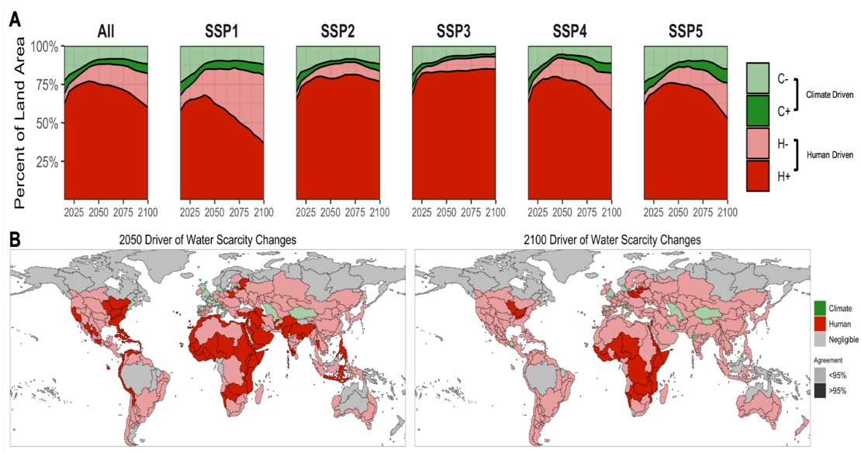
Humans Dominate Future Water Scarcity Changes across Various Socioeconomic Scenarios
Objective
Understand the main driver and direction of future water scarcity changes across a variety of scenarios
Approach
Evaluated the impact of evolving human and climate systems on water scarcity
Included climate impacts to various water system components, including total water availability
Quantified the relative and combined impacts from both systems on human and climate systems across socioeconomic and climatic scenario combinations
Impact
Found that despite a wide range of human and climate futures, the human system dominates future water scarcity changes across all scenarios
Determined the human system can act to decrease water scarcity in nearly half of the total global land area with certain socioeconomic–climate combinations
Identified areas where economic investments in water-efficient technologies may help counteract future climate system impacts
Factors that influence water scarcity change over time and around the world indicate that changes over a large portion of the globe can be attributed to human activity.
Graham NT, MI Hejazi, M Chen, EGR Davies, JA Edmonds, SH Kim, SWD Turner, X Li, CR Vernon, K Calvin, F Miralles-Wilhelm, L Clarke, P Kyle, R Link, P Patel, AC Snyder, MA Wise. 2020. “Humans drive future water scarcity changes across all Shared Socioeconomic Pathways,” Environmental Research Letters, 15: 014007-014016.
DOI: 10.1088/1748-9326/ab639b
Notes:
http://www.pnnl.gov/science/highlights/highlights.asp?division=749

