Slide 1
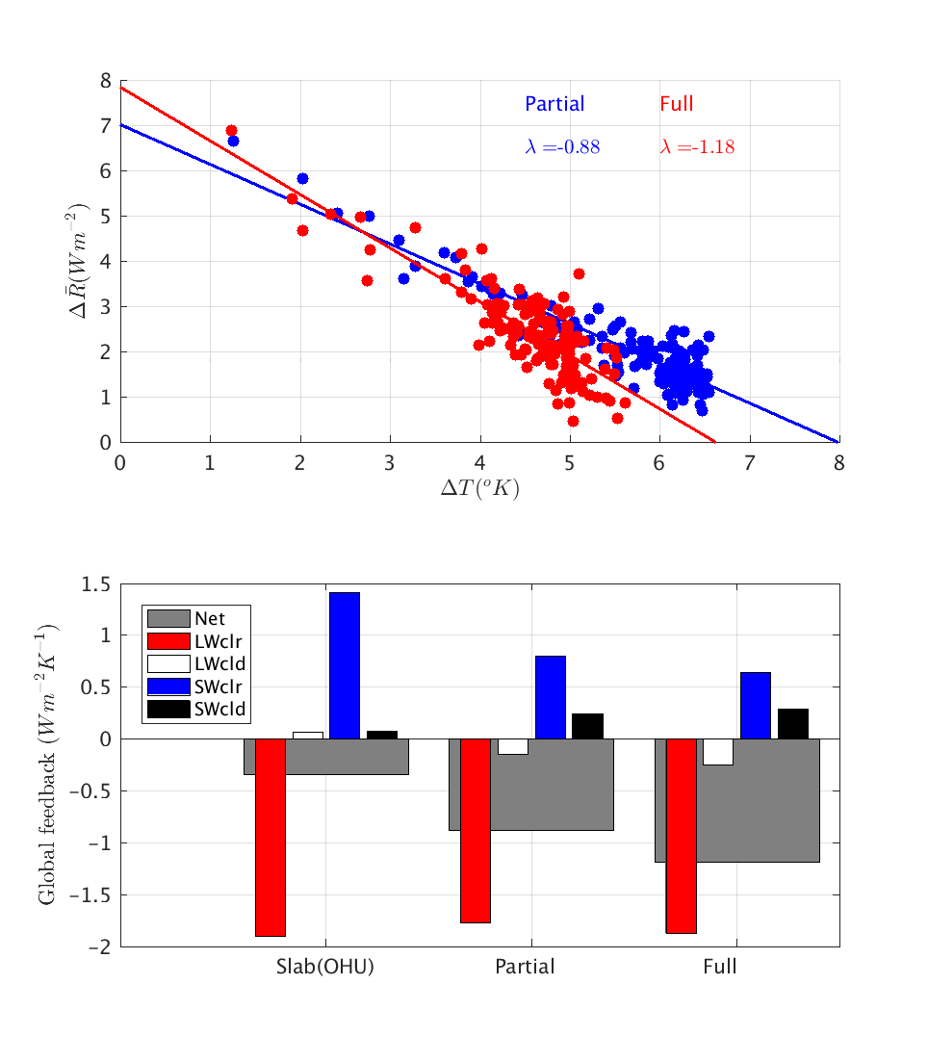
The Role of Active Ocean Feedback in Transient Climate Sensitivity
Objective
Unravel the role of ocean circulation changes in the time-dependent behavior of the global mean temperature response to carbon dioxide forcing
Approach
Build a partially coupled version of the Community Earth System Model using two ocean temperature tracers
Achieve partial coupling by disabling the interaction of the ocean dynamically induced temperature signal with the atmosphere
Impact
New approach fills the gap between the fully coupled climate system and the system with only a thermodynamic ocean
Difference in the surface flux between the fully coupled and partially coupled model responses revealed the effect of active ocean heat uptake
active OHU
TOP: Disabling the active ocean heat uptake (blue, compared against the red) acts to reduce the negative climate feedback. BOTTOM: The breakup of the climate feedback processes shows the importance of albedo and cloud feedbacks.
Garuba OA, J Lu, F Liu, and HA Singh. 2018. “The Active Role of the Ocean in the Temporal Evolution of Climate Sensitivity.” Geophysical Research Letters 45:306-315. DOI: 10.1002/2017GL075633
Notes:
http://www.pnnl.gov/science/highlights/highlights.asp?division=749

