Slide 1
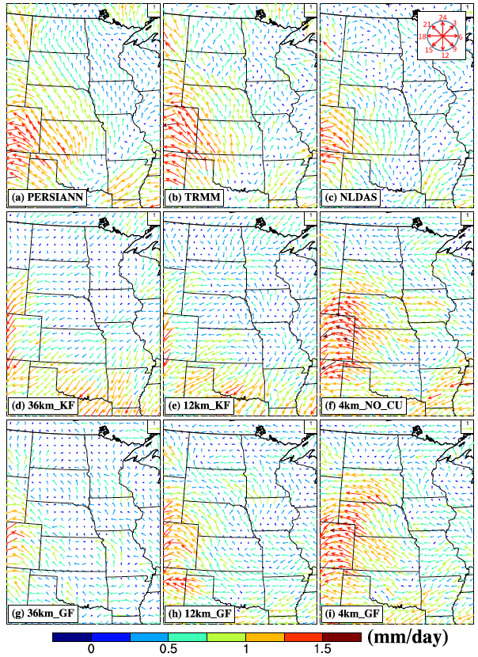
Sensitivity of U.S. Summer Precipitation to Model Resolution and Convective Parameterizations Across Gray Zone Resolutions
Objective
Evaluate the effects of model resolution and convective parameterizations on simulation of U.S. summer precipitation
Approach
Perform a set of simulations using the Weather Research and Forecasting model at resolutions of 36 km, 12 km, and 4 km using the Kain-Fritsch and Grell-Freitas cumulus parameterizations for a wet and a dry summer over the U.S.
Compare simulations of the spatial distribution, diurnal variability, and propagating features of precipitation with observed characteristics
Investigate the warm bias over the central U.S. using simulations with and without nudging and a water budget analysis
Diurnal precipitation cycle over the Great Plains, with the length/color and direction of the arrows indicating the magnitude of precipitation maxima in mm/day and timing of precipitation maximum in local standard time, respectively. Observations at the top are for the PERSIANN, TRMM, and NLDAS data sets. The middle and bottom panels show more realistic simulations at 4 km resolution and using the Grell-Freitas scheme.
Impact
This study showed a promising method to significantly improve the realism of precipitation simulations at a continental scale through high-performance computing and convection-permitting climate modeling
Gao Y, LR Leung, C Zhao, and S Hagos. 2017. “Sensitivity of U.S. Summer Precipitation to Model Resolution and Convective Parameterizations Across Gray Zone Resolutions.” Journal of Geophysical Research: Atmospheres 122. DOI: 10.1002/2016JD025896
Notes:
http://www.pnnl.gov/science/highlights/highlights.asp?division=749

