Slide 1
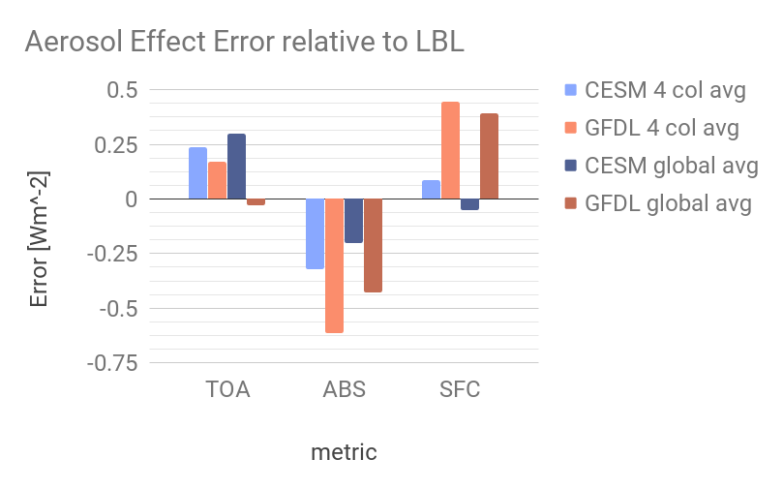
A New Way to Uncover Aerosol Radiative Forcing Errors
The goal was to develop a new approach to addressing a persistent source of uncertainty in the ensemble of earth system model projections: the quantification of the warming or cooling caused by aerosols including dust, sulfate, soot, and sea-salt.
This work, as part of RFMIP, uses native model error diagnostics and represents a conceptual advance that can pinpoint the sources of error that are relevant for model-specific debugging and can narrow the range of model uncertainty from aerosol effects.
Models run traditional experiments (e.g., historical, representative concentration pathways, etc.) and then report a detailed set of fields that form the inputs to benchmark radiative transfer calculations.
These diagnostics enable model-specific error determination.
Proof-of-principle calculations with two different earth system models to show that the nature of their aerosol forcing errors are highly dissimilar.
Citation: Jones, A.L., D.R. Feldman, S. Freidenreich, D. Paynter, V. Ramaswamy, W.D. Collins, R. Pincus (2017), A New Paradigm for Diagnosing Contributions to Model Aerosol Forcing Error, Geophysical Research Letters, doi:10.1002/2017GL075933.

