Slide 1
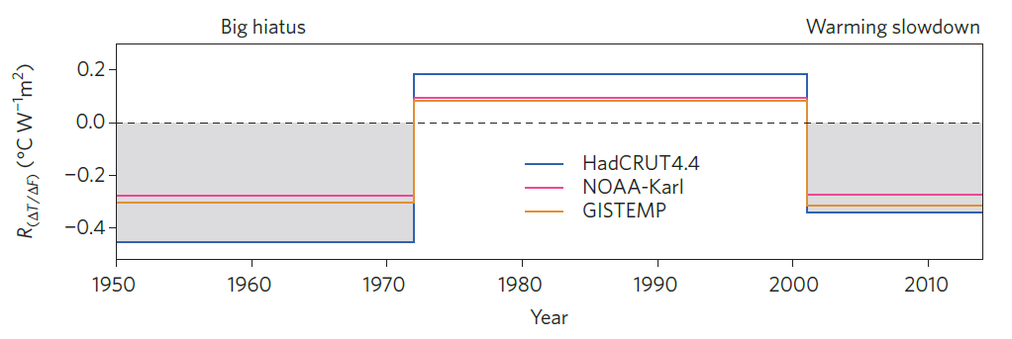
Making sense of the early-2000s warming slowdown
Objective
It has been claimed that the early-2000s global warming slowdown or hiatus, characterized by a reduced rate of global surface warming, has been overstated, lacks sound scientific basis, or is unsupported by observations. The evidence presented here contradicts these claims.
Negative IPO Positive IPO Negative IPO
Anomalies in the ratio of trends in annual mean and global mean surface temperature, to trends in anthropogenic radiative forcing. The ratio of the trends over each period (1950-72 for negative IPO, 1972-2001 for positive IPO, and 2001-2014 for negative IPO) is expressed as an anomaly relative to the trend computed over the full period from 1950 to 2014. The negative signs of this ratio during periods of negative IPO, and positive sign during positive IPO, demonstrate how internally generated decadal variability can slow (negative IPO) or accelerate (positive IPO) warming from steady increases in radiative forcing from increasing greenhouse gases
Approach
Analyze global mean surface temperature (GMST) trends as a function of phase of the Interdecadal Pacific Oscillation (IPO)
For different IPO phases, compute anomalies in the ratio of trends in GMST, to trends in anthropogenic radiative forcing, relative to the full 1950-2014 period
Impact
The rate of warming over the early twenty-first century (IPO was in its negative phase), is slower than that of the previous few decades (IPO in its negative phase), and these decadal fluctuations are superimposed on a long term multi-decadal warming trend.
Fyfe, J.C., G.A. Meehl, M.H. England, M.E. Mann, B.D. Santer, G.M. Flato, E. Hawkins, N.P. Gillett, S.-P. Xie, Y. Kosaka, and N.C. Swart, 2016: Making sense of the early-2000s warming slowdown. Nature Climate Change, 6, 224—228, doi:10.1038/nclimate2938.

