Slide 1
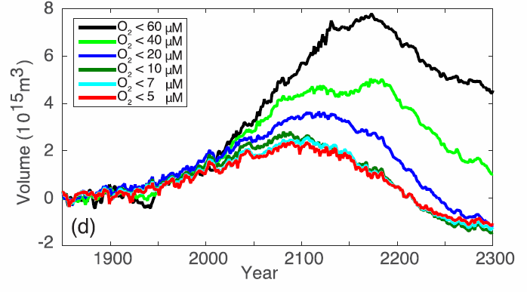
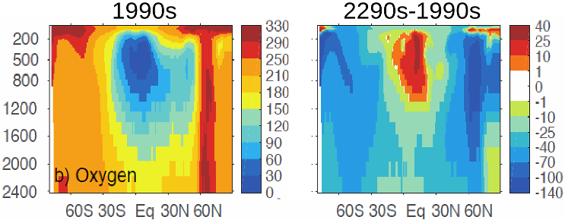
Reversal of Increasing Tropical Ocean Hypoxia Trends with Sustained Climate Warming
Objective: To study long-term changes in tropical ocean oxygen caused by climate warming.
Approach: Analyze a Community Earth System Model (CESM1-BGC) simulation to year 2300 and compare the model with World Ocean Atlas observations.
Results/Impacts: During the 21st century, the volume of low oxygen water increases due primarily to temperature-driven reduction in solubility. After 2100, decreases in tropical ocean nutrient availability and surface biological export more than offset solubility changes, shrinking hypoxic zones.
Figure 1: Volume of tropical low oxygen ocean intermediate waters first increases, and the declines after 2100.
Depth (m)
Fu, Weiwei, F. Primeau, J. K. Moore, K. Lindsay, and J. T. Randerson (2018), Reversal of increasing tropical ocean hypoxia trends with sustained climate warming, Global Biogeochem. Cycles, 32, doi:10.1002/2017GB005788.
Figure 2: Oxygen concentrations in the contemporary ocean (left) and changes by 2300 (right). Units are μM O₂.

