Slide 1
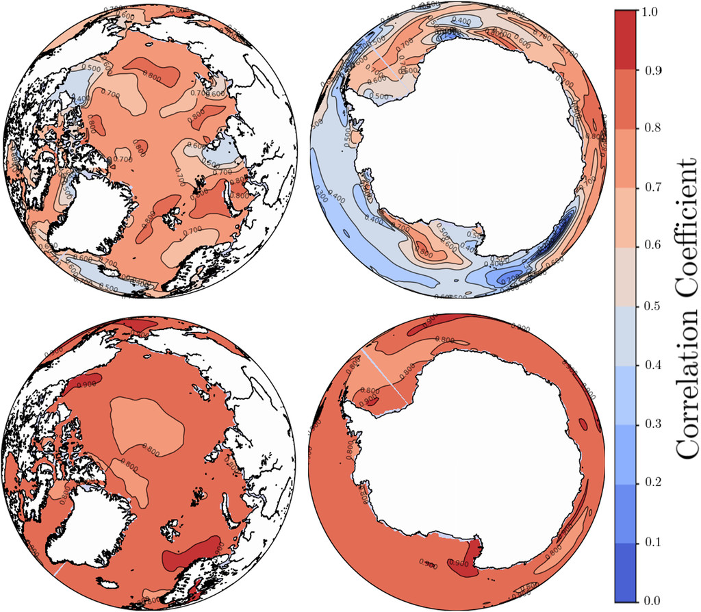
A Bayesian Approach to Regional Decadal Predictability: Sparse Parameter Estimation in High-Dimensional Linear Inverse Models of High-Latitude Sea Surface Temperature Variability
Objective
Linear inverse models (LIMs) are commonly used as a reduced order model for climate applications, including predictability. We aim to improve upon LIM predictive skill by allowing for LIM parameters to be calculated using Bayesian inference, rather than as conventional point estimates calculated using maximum likelihood (ML).
Research
Implement, calibrate, and evaluate LIM framework as applied to the forecasting of high-latitude SSTs using modern Bayesian statistical strategies and probabilistic scoring.
Focus on the performance of the Bayesian perspective (in relation to benchmark ML) as a function of the specific prior implemented.
Skill scores of 1 year lead SST predictions of CESM pre-industrial control simulation, with LIM using point estimate parameters (top) vs. Bayesian LIM (bottom). Higher values mean better predictive skill.
Impact
By treating LIM parameters as probability distributions using Bayesian inference, rather than point estimates, predictive skill of LIM is increased.
Reference: Foster, D., Comeau, D., & Urban, N. M. (2020). A Bayesian Approach to Regional Decadal Predictability: Sparse Parameter Estimation in High-Dimensional Linear Inverse Models of High-Latitude Sea Surface Temperature Variability, Journal of Climate, 33(14), 6065-6081. https://doi.org/10.1175/JCLI-D-19-0769.1

