Slide 1
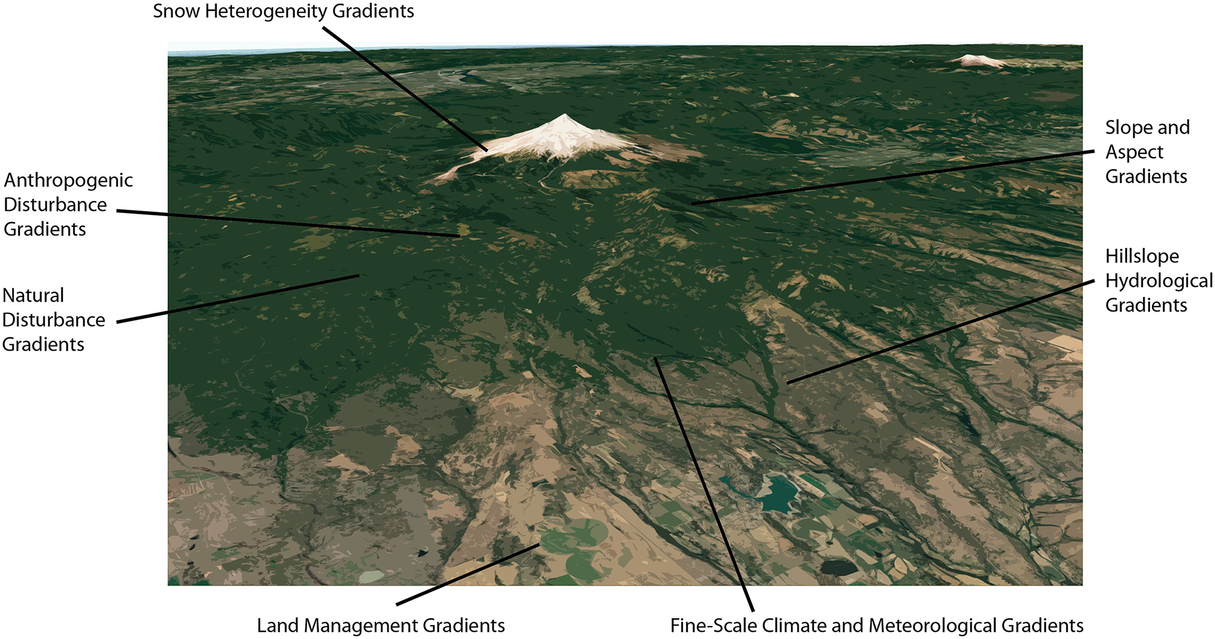
Three Grand Challenges for Land Surface Models
Review of the history and trajectory of land surface models (LSMs), with a focus of three “grand challenges”. We focus on emerging approaches in handling model complexity, land surface heterogeneity, and parametric variation as key factors that may help move beyond current
Invited Manuscript for AGU Centennial Collection on “Grand Challenges in Earth and Space Sciences”, goal is to focus the global LSM community on approaches that will allow us to, first, better characterize the stubborn uncertainty in LSM predictions, and, next, reduce it.
Schematic of multiple intersecting dimensions of heterogeneity below the scale of an LSM gridcell. One “Grand Challenge” is the need to understand when and how to represent each of these, and others, globally.
(1) How do we manage complexity in LSMs? We argue for more emphasis on approaches that allow complexity scaling in LSMs, and experiments designed more around controlled structural and parametric uncertainty than ensembles of opportunity
(2) How do we unify approaches for choosing which dimensions of sub-gridscale heterogeneity to represent? Need to better understand how variation along, e.g. hillslopes, recent weather, and disturbance interact
(3) How do we understand changing parameters in a coupled physical-ecological world? What are the consequences of using empirical, optimality-based, or competitive approaches for representing ecological dynamics?
Fisher, R. A., and Koven, C. D. (2020), Perspectives on the Future of Land Surface Models and the Challenges of Representing Complex Terrestrial Systems, Journal of Advances in Modeling Earth Systems, doi:10.1029/2018MS001453

