Slide 1
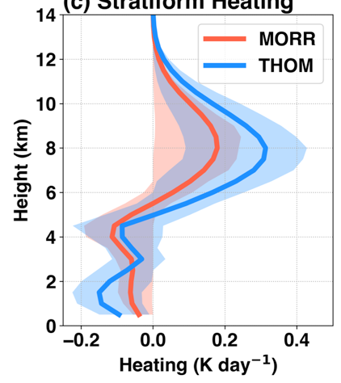
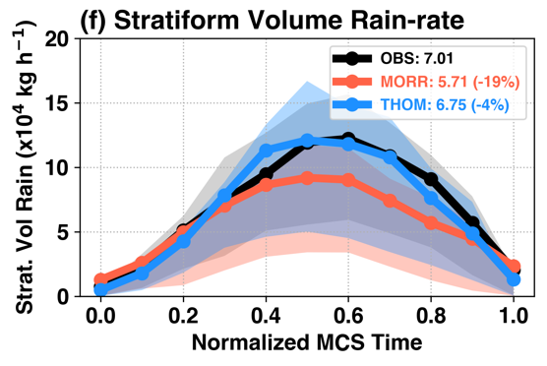
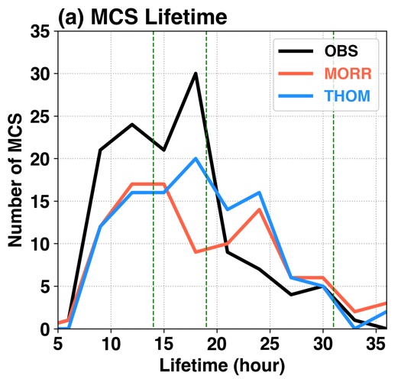
Storm System Longevity over United States Depends on Cloud Microphysical Processes
Objective
Evaluate sensitivity of mesoscale convective system (MCS) properties to model representation of cloud microphysical processes
Approach
Perform convection-permitting regional climate simulations using the Weather Research and Forecasting model over the United States with two different microphysics parameterizations
Track MCSs in both simulations, and evaluate against satellite and 3-D radar observations
Compare composite MCS diabatic heating and synoptic (large)-scale environment anomalies to clarify upscale-feedback processes from cloud microphysics
Impact
With the microphysics parameterization that produces more realistic (stratiform) rainfall, diabatic heating produces stronger mesoscale vortices, which prolong the MCS lifetime, resulting in more rain
Cloud microphysics plays a substantial role in the evolution of an MCS, so evaluating and improving its representation in weather and climate models is critical for understanding and modeling MCSs and their hydrological effects
MCS Stratiform Heating
MCS Stratiform Rainfall
Strong heating
Weak heating
Weak Environmental Feedback
Strong Environmental Feedback
Relative location to MCS center
Relative location to MCS center
MCSs with more realistic stratiform rainfall (top left) produce more-top-heavy diabatic heating (top right), and stronger mesoscale vortex circulation feedback (middle), feeding cooler and drier air to the rear of the MCS region, which helps prolong its lifetime (bottom).
Z Feng, LR Leung, RA Houze, S Hagos, J Hardin, Q Yang, B Han, and J Fan. 2018. “Structure and Evolution of Mesoscale Convective Systems: Sensitivity to Cloud Microphysics in Convection-Permitting Simulations over the U.S,” Journal of Advances in Modeling Earth Systems 10:1470-1494. https://doi.org/ 10.1029/2018ms001305.
Notes:
Tiny Processes in Clouds Drive Storm System Longevity over the Central United States
With improved cloud microphysics representing observed storm structures, models can better simulate long-lasting storms prone to produce flooding.
The Science
Mesoscale convective systems (MCSs) are a form of massive organized thunderstorms that can last up to 24 hours, and are projected to increase in both frequency and rainfall amount across the US by the end of this century. While climate models with spatial resolution comparable to regional weather forecasting models can simulate the large-scale storm environment, details of how to represent cloud microphysical processes remain uncertain. To assess the significance of microphysical processes, researchers at the U.S. Department of Energy’s Pacific Northwest National Laboratory analyzed season-long simulations of MCSs with two different representations of cloud microphysics. They found that the cloud microphysical treatment with more slow-falling snow particles produced more realistic storm rainfall areas and longer-lived storms with greater flood potential, which indicates microphysical processes have important effects on the evolution of the storms.
The Impact
As next-generation climate models continue to increase in resolution and complexity, physical processes such as cloud microphysics play a more prominent role in model uncertainties. This study suggests that cloud microphysics will greatly affect simulations of the hydrological cycle and extreme precipitation events in the climate system. Understanding the interactions and feedbacks between microphysics in MCSs and large-scale environments is important for better understanding and projecting the effects of warming temperatures on changes in hydrological extremes associated with MCSs.
Summary
MCSs are responsible for well over half of warm-season (March to August) rainfall over the Great Plains of the United States. MCSs are not only associated with floods, but they can also produce severe weather such as hail and damaging wind. Recent research shows that long-lived MCSs over the U.S. Great Plains have become more frequent and produced more abundant rainfall over the past 35 years. By the end of this century, MCSs in certain parts of North America are projected to triple their frequency and nearly double the amount of heavy rainfall. However, significant uncertainties remain in our understanding and model representation of cloud microphysical processes, such as water phase changes, in MCSs.
To better understand how microphysical processes influence MCS properties and interact with large-scale environments, researchers performed continental-scale, convection-permitting simulations of the 2011 warm season across the central U.S. with two different state-of-the-art cloud microphysics representations. Then they tracked the simulated MCSs and evaluated them against geostationary satellite and 3-D radar network observations using a newly developed tracking algorithm. While both simulations reasonably captured the MCS precipitation amount, intensity, spatial distribution, and diurnal cycle, properties such as the MCS size, horizontal and vertical structures, and propagation speed differed substantially. The microphysics representation that produced more realistic rainfall from the stratiform portion of the MCS had more-top-heavy heating profiles fed by condensation. This configuration enhanced the circulation behind MCSs, drawing more cool and dry air into the rear of the MCSs and prolonging MCS lifetimes. Researchers found that long-lived MCSs produced two to three times more precipitation than short-lived ones, suggesting cloud microphysics model treatments have profound effects on simulations of extreme precipitation and the hydrologic cycle.

