Slide 1
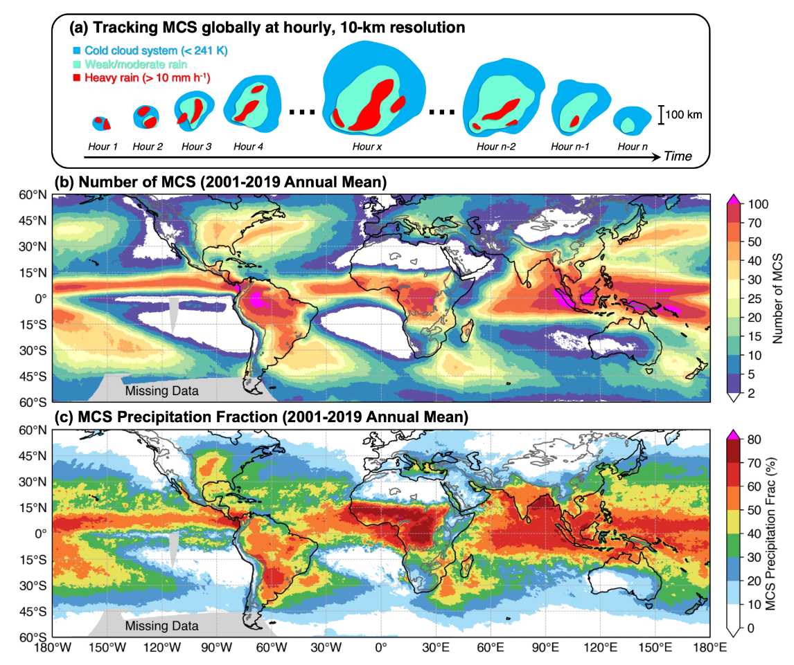
Building a Global Database to Track Mesoscale Storms
Objective
Develop a global, long-term, and high-resolution mesoscale convective system (MCS) tracking database for studying MCS global distributions, characteristics and rainfall contributions.
Approach
Combine two high-resolution satellite datasets, cloud-top temperature, and surface precipitation to track MCSs globally.
Evaluate database tracked MCSs against those tracked using reference ground-based radar observations.
Impact
The MCS tracking database is the first to present 20 years (2000-2019) of data for both the tropics and midlatitudes with hourly and 10-km resolution.
MCSs occur frequently in the tropics and several midlatitude regions. They account for over 50% of the annual rainfall across the tropics overall, exceeding 70% in certain regions, with strong seasonal behavior over many areas of the globe.
The longest-lived and heaviest raining MCSs are found over subtropical oceans, while the most intense MCSs primarily occur over land.
Researchers developed a new methodology to track MCSs using high-resolution global satellite data (a). The database reveals the global distribution of MCSs (b) and their contributions to annual rainfall (c). (b) and (c) show the concentration of MCSs and MCS-associated rainfall in the tropics and midlatitude regions.
Z. Feng, L. R Leung, N. Liu, J. Wang, R. A. Houze Jr, & J. Li. “A Global High-resolution Mesoscale Convective System Database using Satellite-derived Cloud Tops, Surface Precipitation, and Tracking”. Journal of Geophysical Research: Atmosphere, 126, e2020JD034202, (2021). [DOI: 10.1029/2020JD034202]

