Slide 1
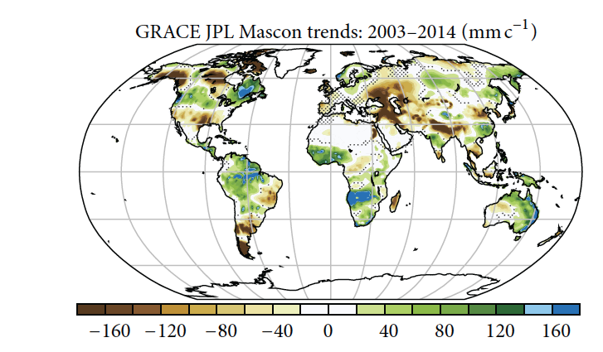
Are GRACE-era Terrestrial Water Trends Driven by Anthropogenic Climate Change?
Objective: Observed trends in terrestrial water storage (TWS) during GRACE (2003–2014) are compared to CESM1-CAM5 Large Ensemble (LE) to assess the extent that observed trends in TWS can be attributed to natural variability versus forced change
Results: Trends during GRACE era in LE are dominated by internal variability rather than by the forced response, with TWS anomalies in Americas, eastern Australia, Africa, and southwestern Eurasia largely attributable to negative phases of PDO and AMO/. While similarities between observed trends and the model-inferred forced response also exist, it is inappropriate to attribute such trends mainly to anthropogenic forcing.
CESM forced trend in TWS
Fasullo, J.T., D.M. Lawrence, S. Swenson, 2016: Are GRACE-Era Terrestrial Water Trends Driven By Anthropogenic Climate Change? Adv in Meteor., 2016, doi:10.1155/2016/4830603.

