Slide 1
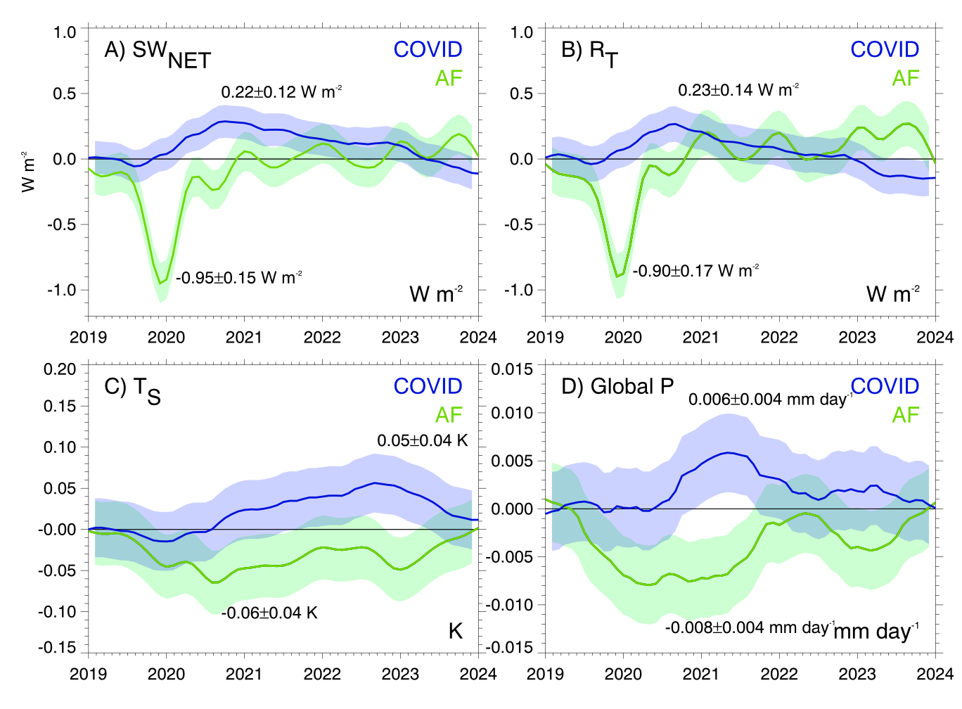
Coupled Climate Responses to Recent Australian Wildfire and COVID-19 Emissions Anomalies Estimated in CESM2
Fasullo, J. T., N. Rosenbloom, R. R. Buchholz, G. Danabasoglu, D. M. Lawrence, and J.-F. Lamarque, 2021, Geophys. Res. Lett., DOI: 10.1029/2021GL093841.
OBJECTIVE
Estimate climate responses to the major anomalous external forcing events of 2020.
APPROACH
We use community estimates of COVID emissions reductions, develop external forcing datasets to represent emissions from the 2019/20 Australian files, and use these to produce coupled simulation ensembles with CESM2 to estimate associated climate responses.
IMPACT
Our simulations illustrate the strong climate response driven by the Australian wildfires and allow for investigation of associated mechanisms while simultaneously quantifying the relatively weak and slowly evolving response to COVID emissions reductions. The Australian fires are found to be noteworthy in that, via indirect effects on clouds, they drive a strong interhemispheric energetic imbalance anomaly similar to a major volcanic eruption. Akin to the effects of eruptions, a role in driving the 2020/21 La Niña is suggested.
Figure: Evolution of global-mean climate responses to AF and COVID emissions anomalies: (a) TOA SW_{NET} flux, (b) TOA R_{T} flux, (c) surface temperature, and (d) precipitation. Shaded regions and uncertainty ranges denote twice the ensemble standard error ranges and indicated values denote response extrema.

