Slide 1
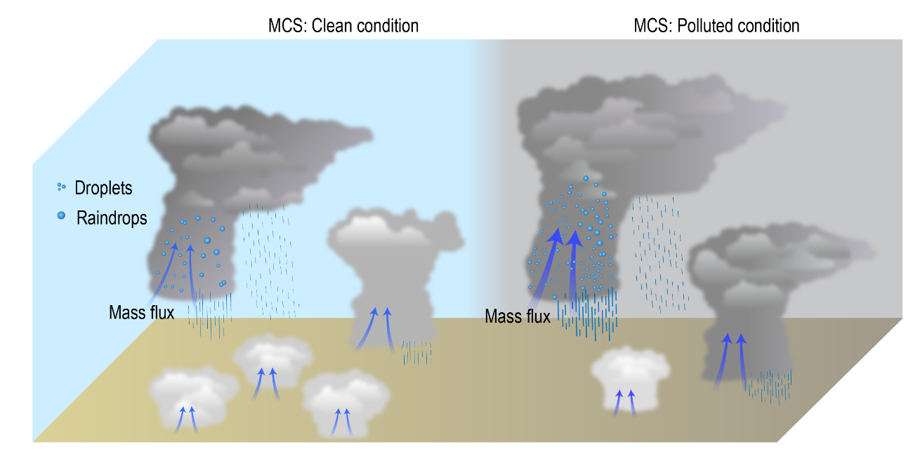
Atmospheric Aerosols Make Storm Systems Larger
Objective
Explore how aerosols impact mesoscale convective systems (MCSs) forming under different wind shear conditions
Approach
Employ the Weather Research and Forecasting model coupled with spectral-bin microphysics
Carry out sensitivity simulations by changing wind shear and aerosol concentrations
Impact
Aerosols enhance vertical mass fluxes, as well as cloud area and precipitation for various MCSs. Below 8 km in altitude, aerosols increase updraft intensity.
Increased aerosols enhance occurrences of deep clouds but suppress shallow clouds
Improved understanding about how various MCSs respond to aerosols has important implications for weather and climate prediction
MCS: clean condition
MCS: polluted condition
In simulations of various mesoscale convective systems (MCSs) in clean (left) and polluted air (right), aerosols enhance (1) vertical mass fluxes, as well as cloud size and precipitation of MCSs and (2) occurrences of deep clouds but suppress shallow clouds.
Chen Q, J Fan, Y Yin, and B Han. 2020. “Aerosol Impacts on Mesoscale Convective Systems Forming under Different Vertical Wind Shear Conditions,” Journal of Geophysical Research: Atmospheres 125: e2018JD030027.
DOI: 10.1029/2018JD030027
Notes:
http://www.pnnl.gov/science/highlights/highlights.asp?division=749

