Slide 1
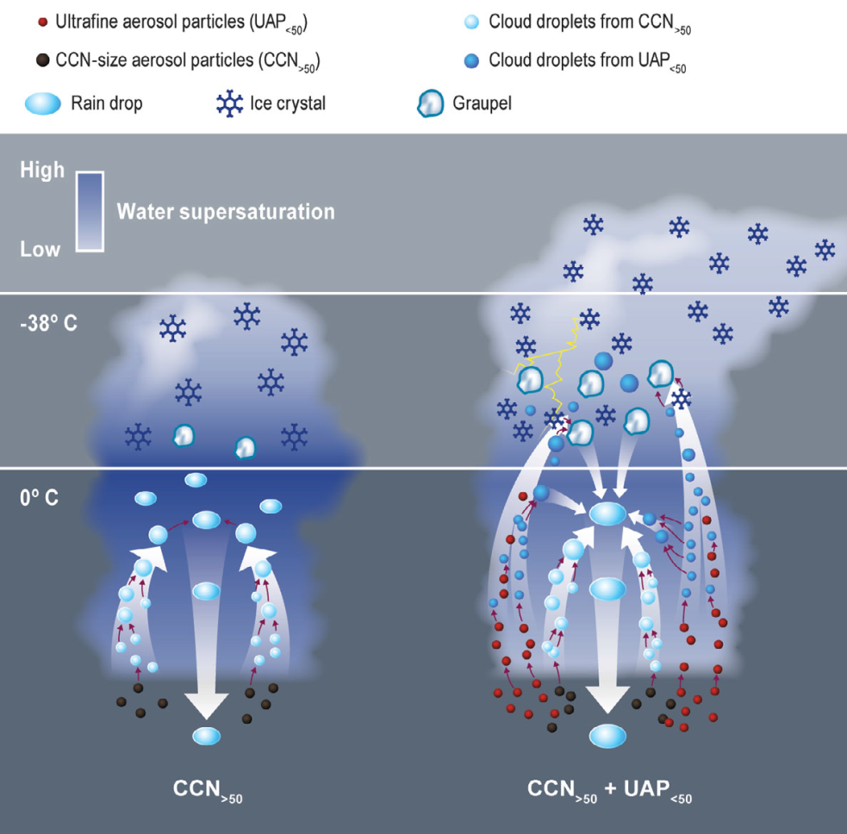
Small Particles Play Large Role in Thunderstorms
Objective
Study how aerosols affect the development of thunderstorms and pinpoint the effects of aerosol particles apart from other factors such as temperature and humidity
Approach
Use the unique GoAmazon observations to discover the effects of ultrafine aerosol particles (UAP) on convective intensity
Use detailed numerical modeling to understand the physical processes and mechanisms responsible for the observed intensification of convection
Impact
UAP, whose effects on clouds have been mostly neglected until now, can invigorate thunderstorms in a much more powerful way than their larger counterparts through enhanced condensation mechanism
The finding suggests that from pre-industrial to the present day, human activity may have changed storms in warm and humid places
Using data from GOAMAZON and numerical modeling, we found small particles play a larger role in tropical storm clouds than bigger particles, primarily due to enhanced condensation.
Fan J, D Rosenfeld, Y Zhang, SE Giangrande, Z Li, LAT Machado, ST Martin, Y Yang, J Wang, P Artaxo, HMJ Barbosa, RC Braga, JM Comstock, Z Feng, W Gao, HB Gomes, F Mei, C Pöhlker, ML Pöhlker, U Pöschl, and RAF de Souza. 2018. “Substantial Convection and Precipitation Enhancements by Ultrafine Aerosol Particles.” Science volume:page numbers. DOI: xxxx
Notes:
http://www.pnnl.gov/science/highlights/highlights.asp?division=749

