Slide 1
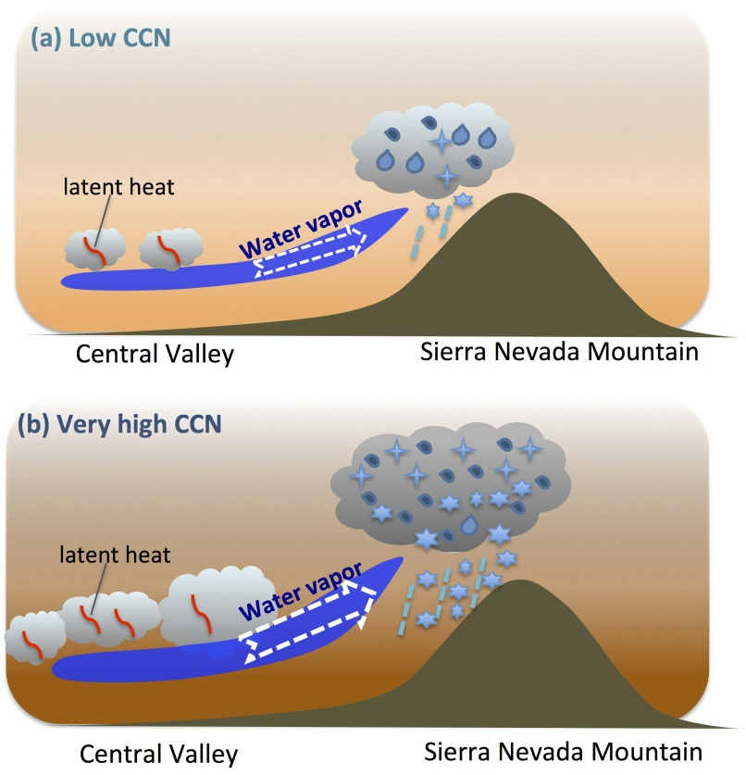
Effects of Cloud Condensation Nuclei and Ice Nucleating Particles on Precipitation and Supercooled Liquid in Mixed-phase Orographic Clouds
Objectives
Understand the dominant ice growth processes in two mixed-phase cloud systems
Quantify the precipitation response to changes of cloud condensation nuclei (CCN) and ice nuclei (IN) over a wide range
Examine CCN and IN impacts on supercooled water content and cloud phases
Approach
Perform very high-resolution (0.5 km) simulations constrained by CalWater field measurements of two cloud cases with contrasting dynamical and thermodynamical conditions
Vary the concentrations of CCN and IN over a wide range from extremely low to extremely high concentrations
Higher CCN concentrations produce more shallow clouds in the Central Valley/foothill. The larger latent heat release changes local circulation and strengthens the transport of moisture to the windward slope, invigorating mixed-phase clouds over the mountains to produce larger amounts of snow precipitation
Impact
Discover a new mechanism for how anthropogenic aerosols (CCN) can invigorate orographic mixed-phase clouds and dramatically increase snow precipitation.
Significant implications for orographic precipitation in very polluted regions such as China and India
Fan J, LR Leung, D Rosenfeld, PJ DeMott. 2017. “Effects of Cloud Condensation Nuclei and Ice Nucleating Particles on Precipitation Processes and Supercooled Liquid in Mixed-phase Orographic Clouds.” Atmospheric Chemistry and Physics 17:1017-1035. DOI:10.5194/acp-2016-77.
Notes:
http://www.pnnl.gov/science/highlights/highlights.asp?division=749

