Slide 1
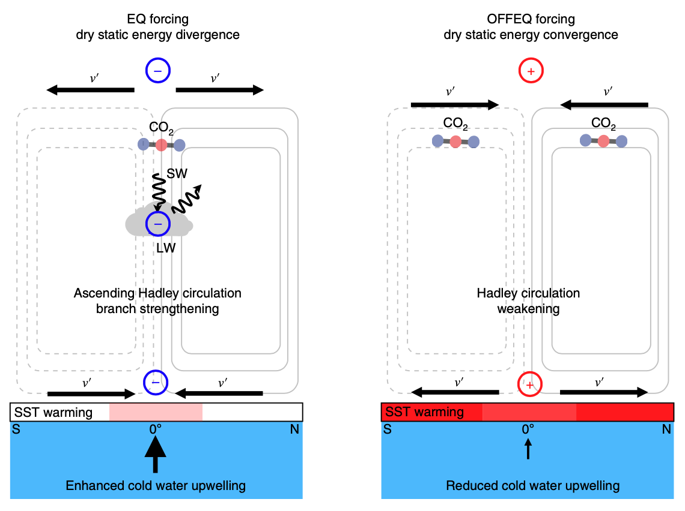
Strong remote control of future equatorial warming by off-equatorial forcing
Malte F Stuecker, Axel Timmermann, Fei-Fei Jin, Cristian Proistosescu, Sarah M Kang, Doyeon Kim, Kyung-Sook Yun, Eui-Seok Chung, Jung-Eun Chu, Cecilia M Bitz, Kyle C Armour, Michiya Hayashi, Nature Climate Change, 1-6, https://www.nature.com/articles/s41558-019-0667-6
Science
The tropical climate response to greenhouse gas forcing is spatially non-uniform. While most models simulate an enhanced warming on the equator, the physical mechanisms responsible for it remain debated. Here, we developed a new theory to explain this tropical warming pattern using a hierarchy of idealized climate model experiments. We found that off-equatorial radiative forcing is responsible for most of the equatorial warming due to a coupled feedback that involves the Hadley circulation, oceanic subtropical cells, and clouds.
Impact
Our mechanism highlights the role that off-equatorial forcing can play for equatorial warming. For instance, we expect that a future reduction of aerosols in subtropical and mid-latitude Asia would lead to a pronounced warming near the equator.
Summary
We demonstrated the large role that off-equatorial radiative forcing can play in controlling equatorial warming patterns via a coupled feedback involving both circulation and cloud changes.
Funded by DOE RGMA Program
Fig1: Schematic summary of the physical processes explaining the differing surface temperature response to equatorial (left) and off-equatorial (right) radiative forcing where v’ is the anomalous zonal-mean meridional wind in the upper and lower troposphere.

