Slide 1
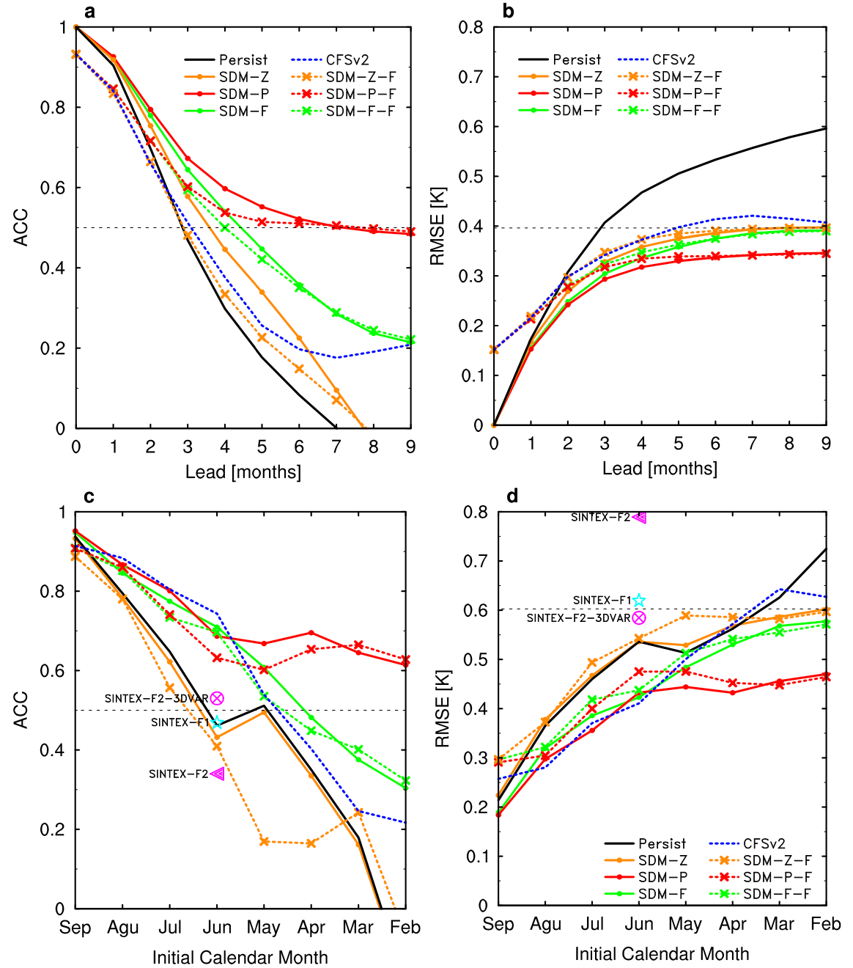
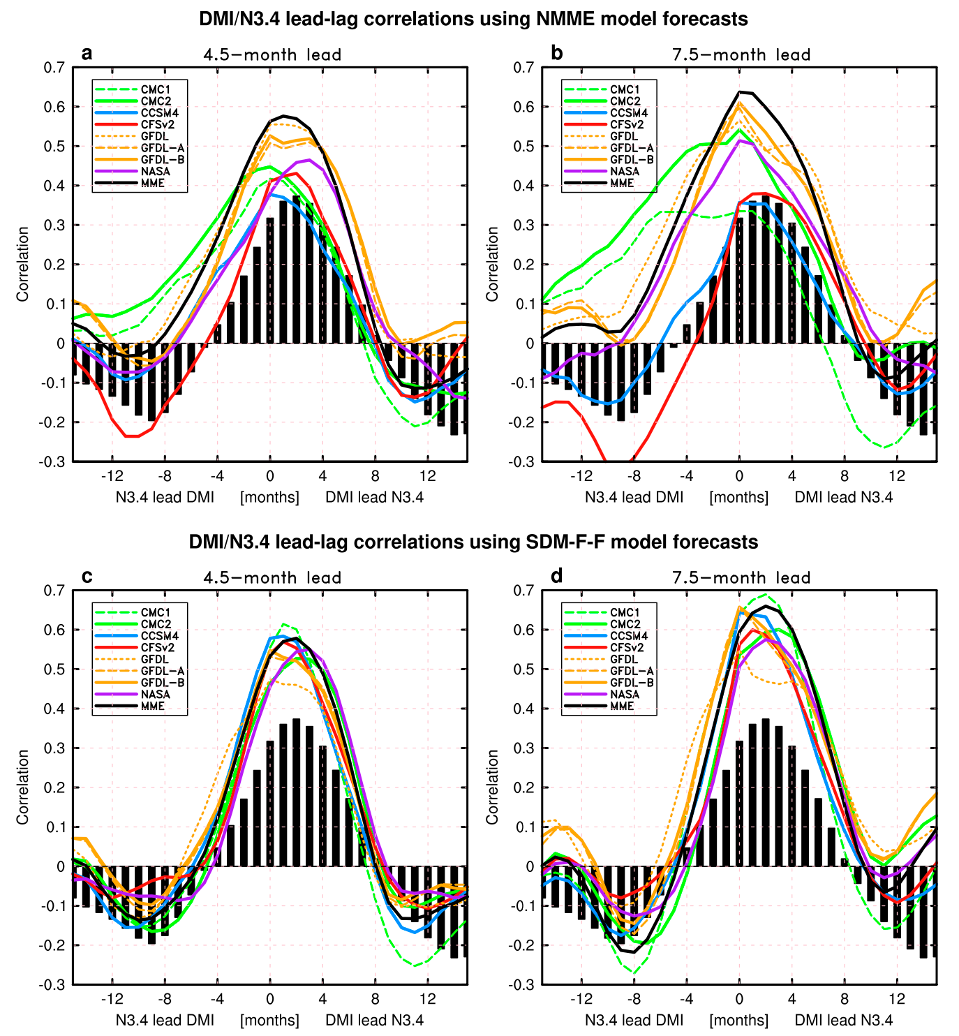
1) Improved Predictability of the Indian Ocean Dipole Using Seasonally Modulated ENSO Forcing Forecasts
Sen Zhao, Fei‐Fei Jin, Malte F. Stuecker GRL, https://doi.org/10.1029/2019GL084196
2) Improved Predictability of the Indian Ocean Dipole Using a Stochastic Dynamical Model Compared to the North American Multimodel Ensemble Forecast
Sen Zhao, Malte F. Stuecker, Fei-Fei Jin, J. Feng, H.-L. Ren, W. Zhang, and J. Li, Wea. Forecasting, https://doi.org/10.1175/WAF-D-19-0184.1
Fig. 1. (a) Anomaly correlation coefficient (ACC) and (b) root‐mean‐square errors (RMSE) (unit: K) between observed and predicted DMI, as a function of lead time for the individual models: persistence (black solid), CFSv2 (blue dashed), cross‐validated SDM‐Z (orange solid), SDM‐Z‐F (orange dashed), SDM‐P (red solid), SDM‐P‐F (red dashed), SDM‐F (green solid), and SDM‐F‐F (green dashed). Both forecasts and verification were smoothed with a three‐month running mean prior to computing ACC and RMSE. (c and d) The same as in (a) and (b), respectively, but for predictive skills of the DMI averaged for peak season SON as a function of initialization month in each year. The black dashed reference lines denote ACC of 0.5 (a and c) and RMSE of 0.4 (b, the standard deviation of the observed DMI) and 0.6 (d, the standard deviation of the observed DMI at SON), respectively.
OBJECTIVE Despite recent progress in seasonal forecast systems, the predictive skill for Indian Ocean Dipole (IOD) remains typically limited to a lead time of one season or less in both dynamical and empirical models. We developed a new simple stochastic‐dynamical model (SDM) to predict the IOD using seasonally modulated El Niño–Southern Oscillation (ENSO) forcing together with a seasonally modulated Indian Ocean coupled ocean‐atmosphere feedback. The SDM demonstrates considerably improved IOD forecast skill compared to current operational models.
Fig. 2. Lead/lag cross correlations between monthly Niño-3.4 index and DMI for the observations (black bars) and the forecasts (curves) at lead times of (a),(c) 4.5 and (b),(d) 7.5 months for (top) the NMME models and (bottom) the SDM-F-F that uses forecasted ENSO forcing and DMI initial values from the NMME models.
APPROACH In the two related papers on the subject, we developed and validated a simple stochastic-dynamical model (SDM) to predict the IOD using the forecasted ENSO conditions:
where T is IOD index, T_{ENSO}(t) is the Niño‐3.4 index, λ(t) is the seasonal modulated damping rate, α(t) is the seasonal modulated ENSO forcing strength, ξ(t) is the stochastic forcing. We found that the new SDM constitutes a large improvement compared to current operational IOD predictions (Fig. 1). The forecasted IOD–ENSO relationship deteriorates away from the observed relationship with increasing lead time, which might be one reason that limits the IOD predictive skill in coupled models (Fig. 2).
IMPACT Our findings provide a novel powerful perspective for improving IOD predictions. Importantly, the proposed new model framework can be easily adopted operationally and will allow seasonal forecast centers to translate their skillful ENSO forecasts into much improved predictions of the IOD at significantly longer lead times. These longer lead times are critical for policy makers to be able to implement mitigation measures. Furthermore, our results imply that potential future ENSO improvements in models should also directly translate into more skillful IOD predictions. .
Funded by DOE RGMA Program

