Slide 1
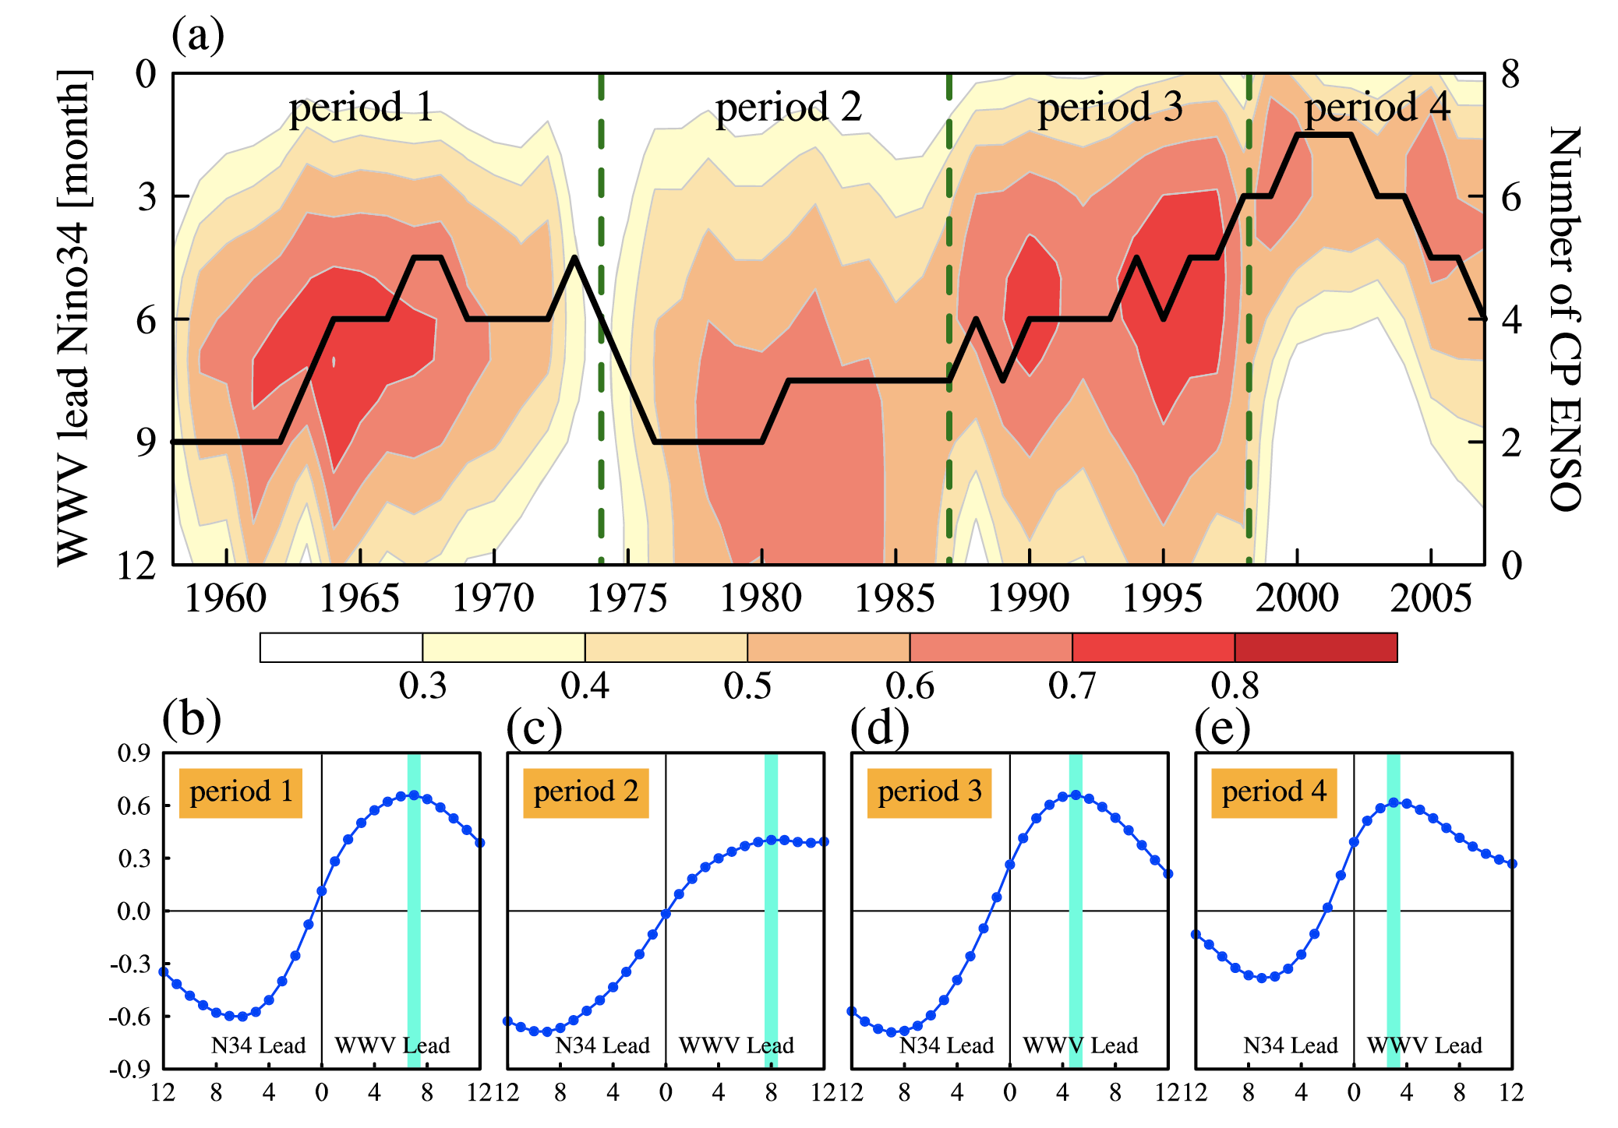
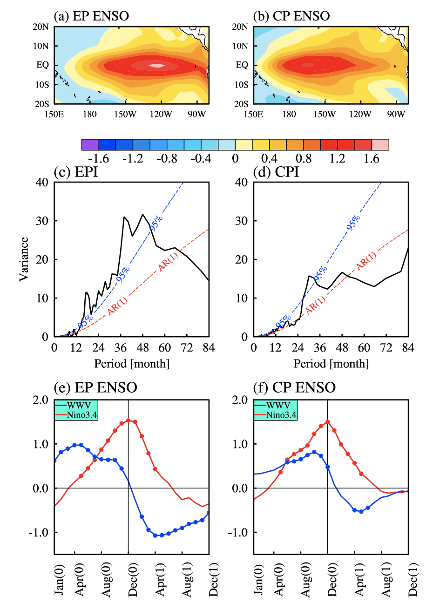
ENSO Regime Changes Responsible for Decadal Phase Relationship Variations Between ENSO Sea Surface Temperature and Warm Water Volume
Fig. 1 (a) Correlation (shading) between WWV and Niño3.4 indices as a function of WWV
lead month (left y axis) and year (x axis), overlaid by the number of CP ENSO events (right y axis), both within a 11-year running window (black thick line). (b–e) Cross correlation between the WWV and Niño3.4 indices during four periods(b) 1958–1974, (c) 1975–1987, (d) 1988–1998, and (e) 1999–2016, which are separated by green dashed lines in (a).
Fig. 2 Composite December-February-mean SST anomaly patterns (°C) for (a) EP and (b) CP ENSO events. Fast Fourier transform power spectrum for the (c) EPI and (d) CPI indices (black thick line). Red and blue dashed lines correspond to an AR(1) null hypothesis and 95% confidence level, respectively. Composite evolution of the normalized warm water volume (WWV; blue line) and Niño3.4 indices (red line) for (e) EP and (f) CP ENSO events. Markers indicate the values
that are statistically significant at the 90% confidence level.
Wenjun Zhang, Sixu Li, Fei-Fei Jin, Ruihuang Xie, Chao Liu, Malte F. Stuecker and Aoyun Xue. Geophysical Research Letters, 46, 7546– 7553. https://doi.org/10.1029/2019GL082943
OBJECTIVE ENSO events can be predicted up to three seasons in advance due to the slow equatorial heat content recharge/discharge in the upper ocean. The warm water volume (WWV), describing upper Pacific Ocean heat content, usually leads the ENSO SST evolution by a quarter of the ENSO period and acts as a useful predictor for ENSO SST. However, this WWV-ENSO SST phase-lag relationship has experienced a significant shift around 2000 with the lead time being shortened from approximately two to three to approximately one seasons. Here we attribute the decadal change of the WWV-ENSO SST phase-lag relation to decadal ENSO regime shifts.
IMPACT In recent decades, the upper ocean heat content (measured by the WWV) displayed a remarkable shift in its lead-lag relation with ENSO SSTA. which can be attributed to decadal ENSO regime shifts. Different regimes are characterized by the predominance of either EP or CP ENSO in different decades. one season for both CP El Niño and La Niña events, in decades with more frequent occurrences of CP ENSO events, the lead time of WWV over Niño3.4 decreases.
SUMMARY Relationship between WWV and Niño3.4 SST varies on decadal timescales, corresponding to the occurrence frequency of central Pacific ENSO. Both eastern and central Pacific ENSO events show recharge/discharge signatures but with different WWV/Niño3.4 phase-lag relationships. This difference can be explained by the existence of two different ENSO types characterized by distinct intrinsic periodicities.
Funded by DOE RGMA Program

