Slide 1
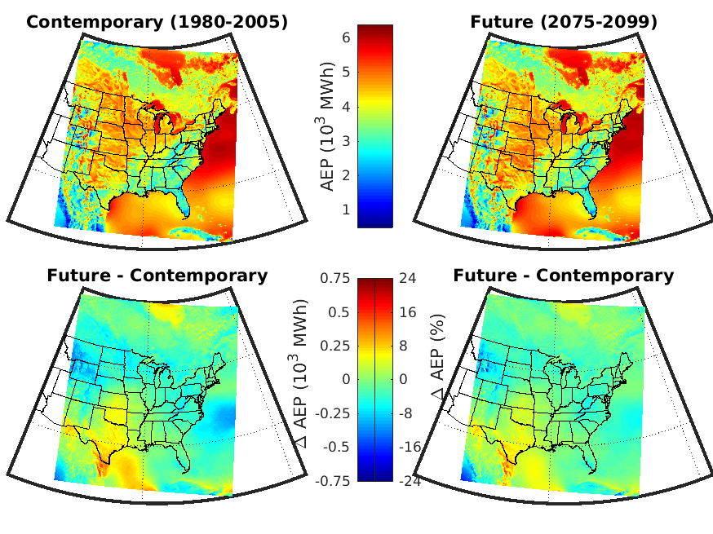
Assessing the stability of wind resource and wind turbine operating conditions
We present simulations with the Weather Research and Forecasting (WRF) model and use them to quantify the spatiotemporal variability in one aspect of wind turbine operating conditions (extreme wind speeds) and possible changes in the magnitude and interannual variability of expected wind power generation.
Wind energy is both a key potential mechanism to reduce climate forcing and a ‘weather-dependent’ energy source. We are advancing techniques to better project how climate change may impact either wind energy resources or operating conditions.
We perform and present moderate resolution (12 km), long-term simulations with WRF and develop new analysis approaches to assess how CREDIBLE projections of wind resources or operating conditions are.
Mean gross expected annual energy production (AEP) for a single 1.6 MW wind turbine deployed at the center of each WRF grid cell for the contemporary and possible future climate derived WRF-MPI. The lower panels show the difference in AEP from the two periods (future minus contemporary) expressed as a difference in mean AEP in MWh (left) and as a percentage of the mean AEP in the contemporary climate (right). As shown, this model chain projects increasing wind resource in the southern Great Plains and declines in the upper Midwest.
Pryor S.C., Shepherd T.J., Bukovsky M. and Barthelmie R.J. (2020): Assessing the stability of wind resource and operating conditions. Journal of Physics: Conference Series 1452 012084 doi: 10.1088/1742-6596/1452/1/012084

