Slide 1
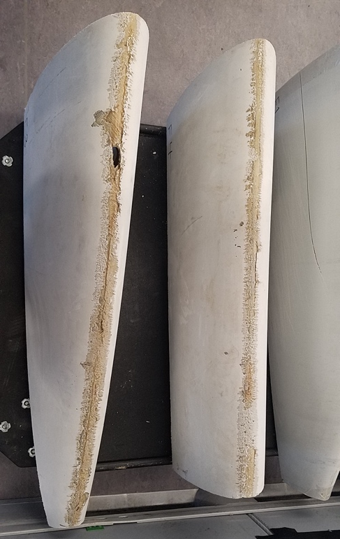
RADAR-derived precipitation climatology for wind turbine blade leading edge erosion
Leading Edge Erosion (material loss) from wind turbine blades reduces electrical power production by upto 5% and causes substantial repair costs. A robust and flexible framework has been developed and presented for generating an observationally constrained georeferenced assessment of precipitation-induced wind turbine blade leading edge erosion potential.
Excess LEE may be costing the wind energy industry tens of millions of dollars per year via lost revenue and/or increased maintenance costs and poses a threat to achieving continuing wind energy cost reductions. Understanding geospatial variability in LEE potential will inform and enable efforts to mitigate LEE.
We have developed a novel approach to characterizing the erosion potential across the contiguous USA based solely on publicly available data products from the National Weather Service dual-polarization RADAR.
Photograph of material loss from part of a decommissioned wind turbine blade. This damage reflects precipitation-induced leading edge erosion.
Letson F.W., Barthelmie R.J., and Pryor S.C. (2020): RADAR-derived precipitation climatology for wind turbine blade leading edge erosion. Wind Energy Science 5 331-347 https://www.wind-energ-sci.net/5/331/2020/wes-5-331-2020.pdf

