Slide 1
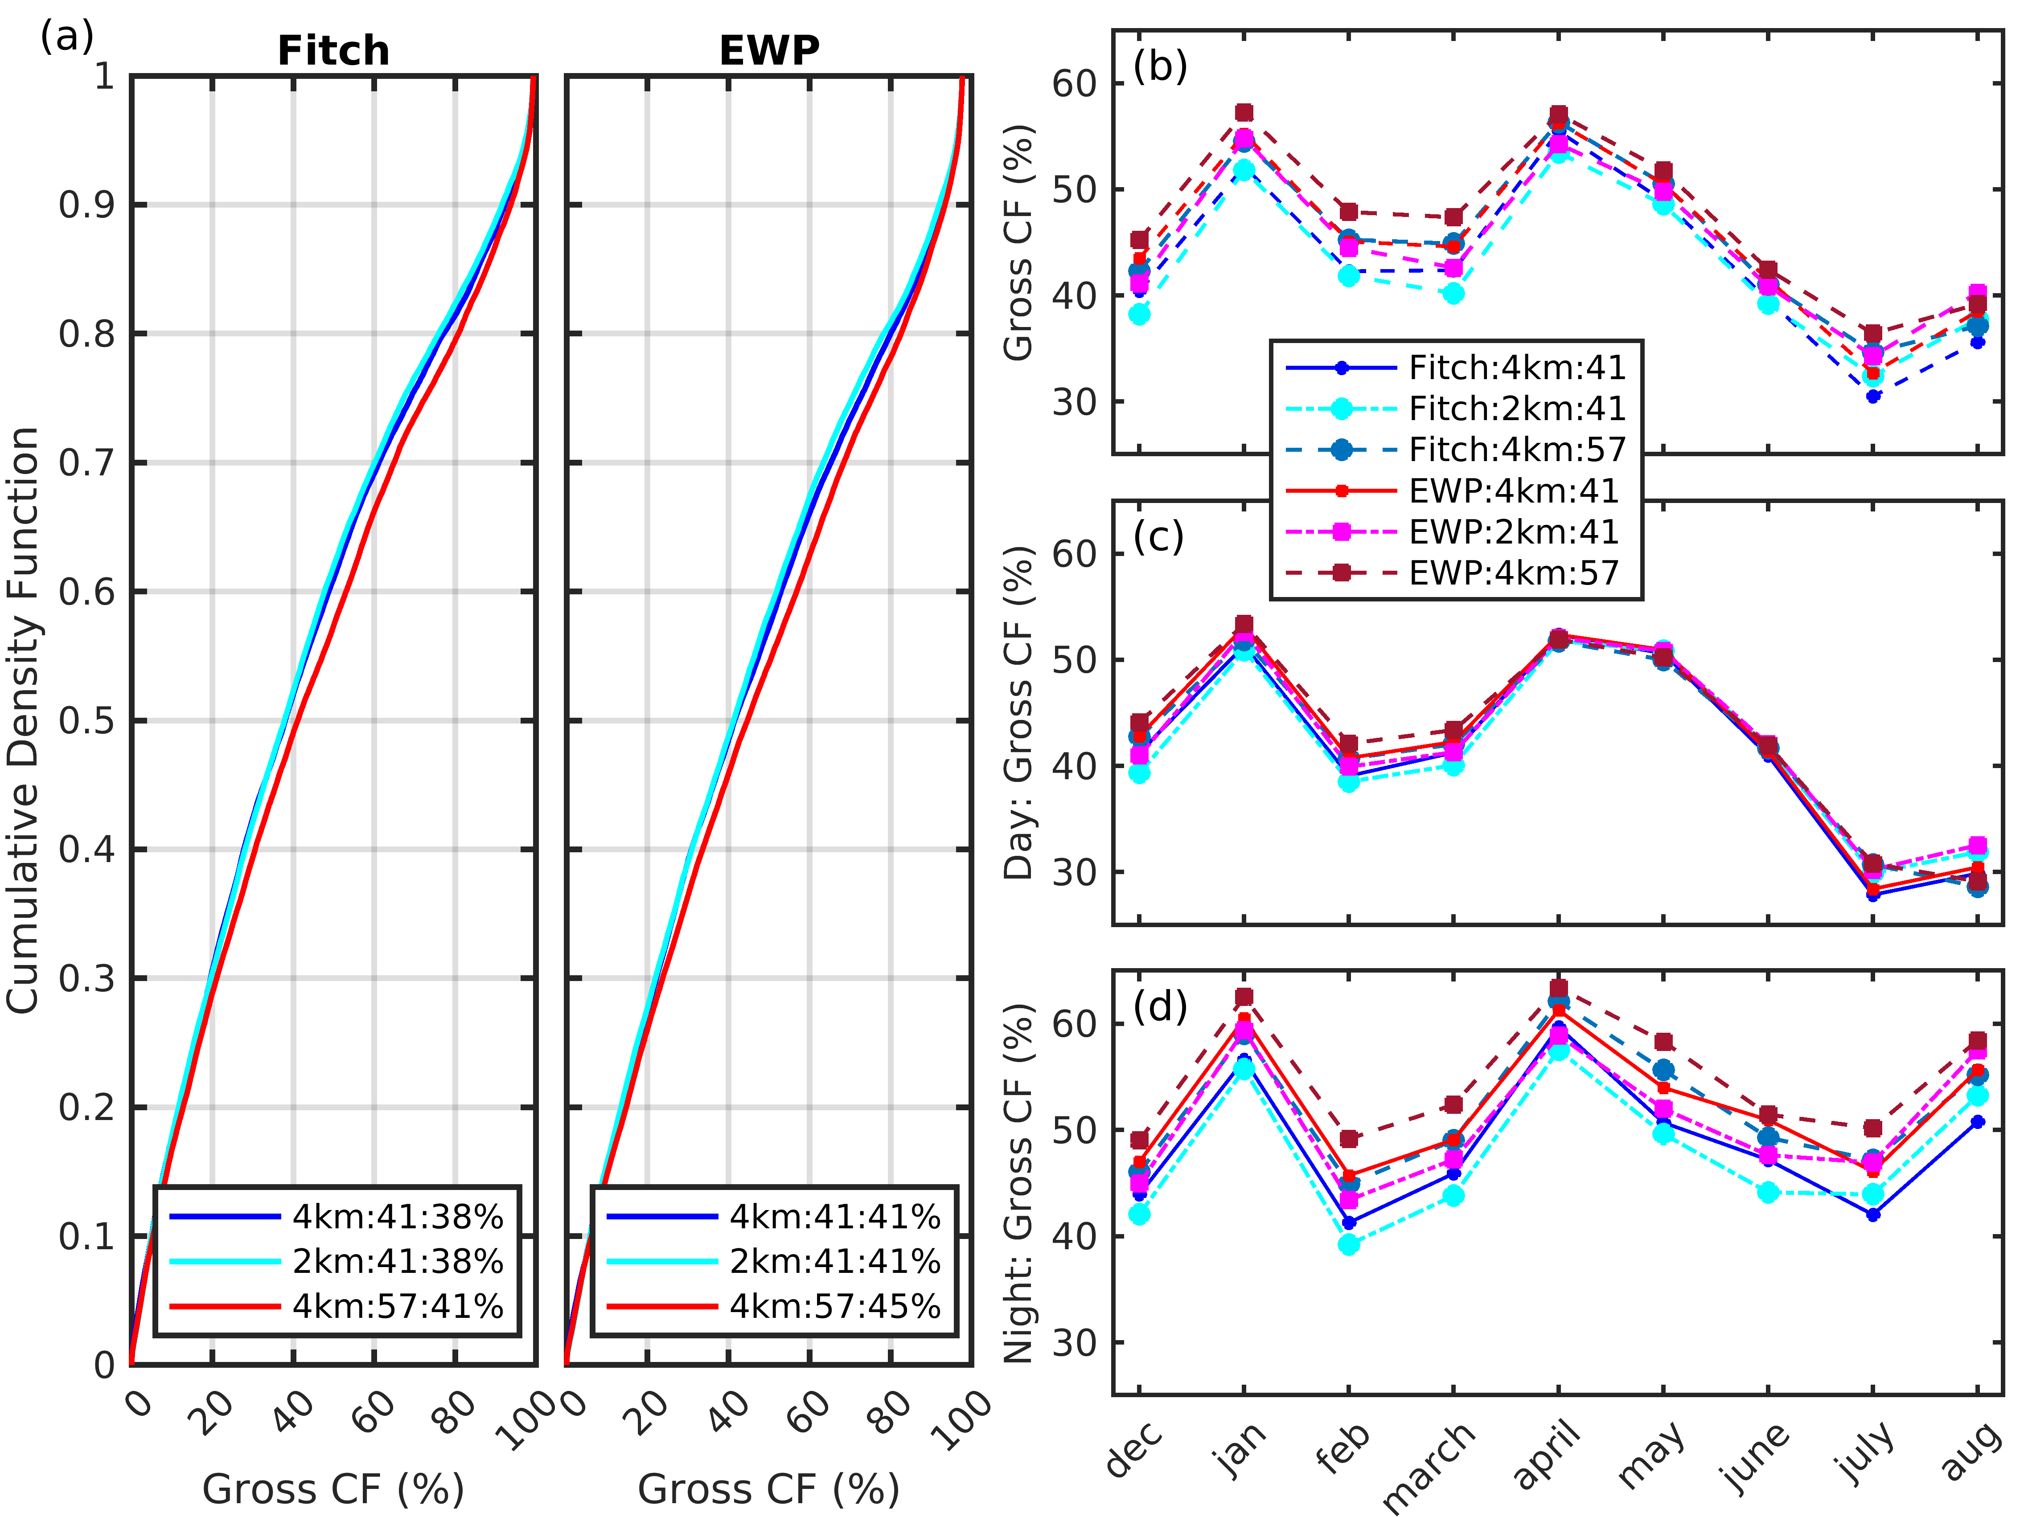
Optimizing wind turbine deployment to maximize power
High-resolution simulations are conducted with the Weather Research and Forecasting (WRF) model in order to quantify downstream effects on atmospheric properties and ‘wind theft’ between wind turbine arrays and advance methods to improve the atmospheric physics parameterizations in WRF.
(a) CDF of al 10-minute system-wide gross capacity factors (CF) from all WT in Iowa (December 1, 2007 to August 31, 2008) (b-d) CF conditionally sampled by month and hour of day for 3 simulation resolutions and two wind farm parameterizations (Fitch and EWP). The three simulation resolutions are; 4km horizontal grid spacing with 41 vertical layers (4km:41), 2 km horizontal grid spacing with 41 vertical layers (2km:41) and 4km horizontal grid spacing with 57 vertical levels (i.e. twice the density of vertical layers in about the lower atmosphere) (4km:57).
In 2016 nearly 89% of US wind farms were located within 40 km of another wind turbine (WT) array. Thus, WT array-array interactions (i.e. impacts from the wake of an upstream wind power plant) should be considered when locating new developments (i.e. new WT arrays) in order to properly characterize projected electrical power production from existing and planned developments.
We present multiple year-long simulations with real WT characteristics and locations and two different wind farm parameterizations to diagnose where discrepancies arise and what magnitude they have.
Pryor S.C., Shepherd T.J., Volker P., Hahmann A.N. and Barthelmie R.J. (2020): ‘Wind theft’ from onshore wind turbine arrays: Sensitivity to wind farm parameterization and resolution. Journal of Applied Meteorology and Climatology 59 153-174. doi: 10.1175/JAMC-D-19-0235.1

