Slide 1
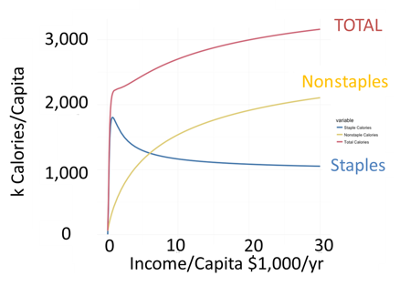
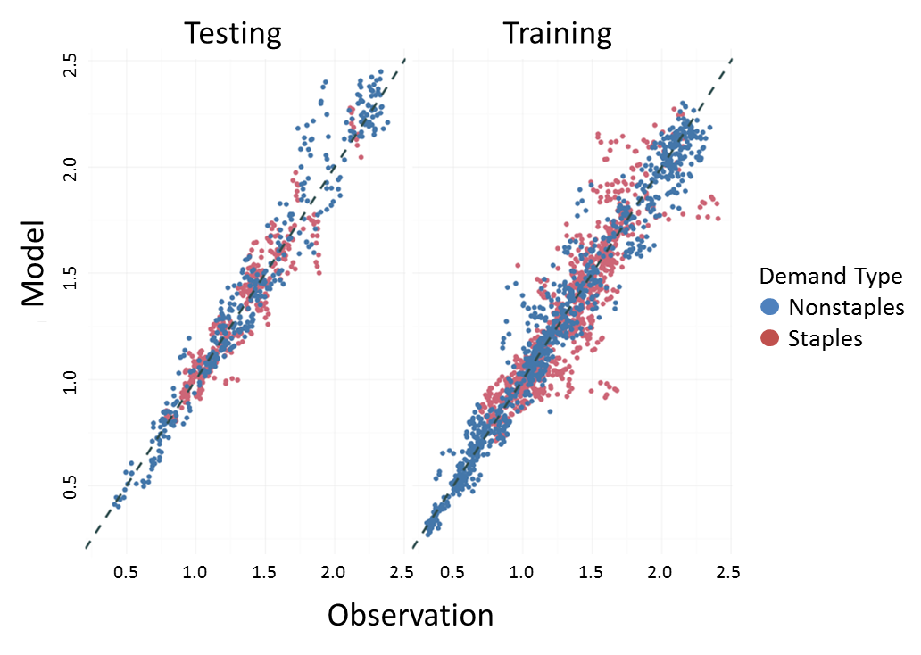
A Global Food Demand Model for the Analysis of Complex Human-Earth Systems
Objective
Develop and test a new consumer choice model to analyze food demand, an important determinant of terrestrial systems
Approach
Develop a new model of consumer choice that addresses the classic economic problem of saturation of food demands at high income levels
Develop a database to estimate the model
Apply advanced statistical techniques to estimate model parameters, cross-validate through hindcasting, and bias-correct to ensure robust predictions
The saturation of food demands at high income levels is a long-standing economic problem. Researchers successfully addressed this problem with a new consumer demand model. The left panel shows the relationship between income and food demands in the model. Researchers estimated model parameters using global cross-section, time-series observations, a technique also called hindcasting. The right panel shows the results from cross-validation with bias correction.
Impact
Developed a new demand system for numerical simulation of food demands that saturate at high per capita incomes
Employed advanced statistical techniques to estimate model parameters, validated with hindcasting, and bias correction
The model will be used in the Global Change Assessment Model (GCAM) to provide a richer and more robust characterization of interactions between human and physical Earth systems
Edmonds JA, R Link, ST Waldhoff, and R Cui. 2017. “A Global Food Demand Model for the Assessment of Complex Human-Earth Systems.” Climate Change Economics 8(4):1750012 (22 pages). DOI: 10.1142/S2010007817500129
Notes:
Utilizing Hindcasting to Calibrate a Human-Earth System Dynamics Model: an Application to Future Food Consumption
The Science
This paper applies advanced statistical techniques and hindcasting to evaluate and calibrate a new model of future global food consumption for use in human-Earth system dynamics models.
The Impact
The paper advances the science of model validation and hindcasting in human-Earth system dynamics models, and it advances understanding of future regional food consumption around the world, a major driver of future land use, land cover, and land use change. It is part of a larger program to better characterize uncertainty in future human-Earth system dynamics. The paper and the methods it describes constitute a potential blueprint for other model elements and other models to follow as they develop.
Summary
Understanding and characterizing the uncertainty in future projections of terrestrial system changes (e.g., land use, land cover, and land use change) is an active area of research. Food consumption is among the most fundamental drivers of these terrestrial system changes. Food consumption, in turn, is shaped by global change through interactions with socioeconomic changes such as population growth and economic prosperity. The paper develops a new model of food demands for use in human-Earth system dynamics models and employs hindcasting and advanced statistical techniques to characterize the food-demand model’s performance and derive numerical values for model parameters.
The new model addresses a long-standing issue in human-Earth system dynamics modeling, namely the evolution of food demand that accompanies large changes in income and agricultural prices occurring in widely varying countries over decades. As people’s wealth increases, their diets change, with important ramifications for agricultural and terrestrial systems more generally. Similarly, changes in prices that might emerge, for example, from drought, will affect the foods people eat. This paper takes a new approach to the representation of these changes that is rooted in decades of historical data and the latest understanding of how people have changed their diets and their food consumption over time across the world. Using historical information from countries around the world, the model projects the demand for two different types of food, staples commodities (for example, grains like corn and wheat) and non-staples (foods like fruits and vegetables).
An important element of the paper is the application of advanced statistical techniques – Bayesian Monte Carlo parameter estimation – to establish numerical values for the parameters of the food demand model. The robustness of the model was tested by developing the model parameters using a “training set” and then applying them to a “testing” data set. Divided data into testing and training sets is a form of “hindcasting”, because the projection is not being made into the future, but rather into data from the past and is therefore testing model performance over history. These “hindcast” experiments demonstrated that the model did a similarly good job of predicting values in both the testing and training data sets. An additional benefit of the statistical techniques used in this paper is that that the statistical characterization of the model parameters can be used to create uncertainty distributions for projections of future food demands in coupled human-Earth system models.
The use of hindcasting and advanced statistical techniques is less common in the development of the human system components of coupled, human-Earth system models than in the physical science components. Targeted approaches like those in this paper provide a template for increasing their future use in coupled, human-Earth system models.

