Slide 1
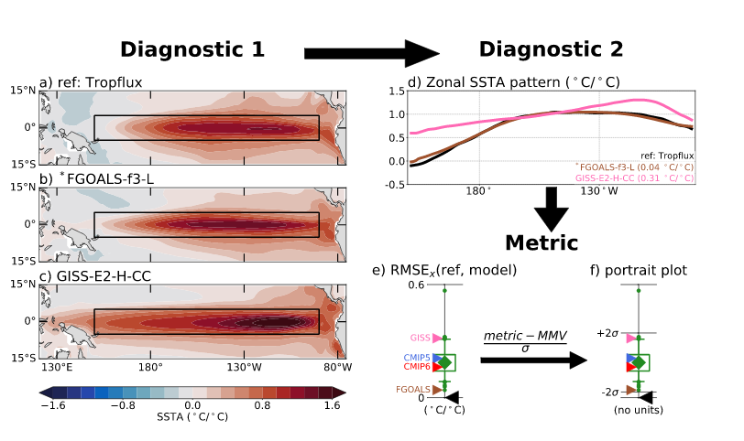
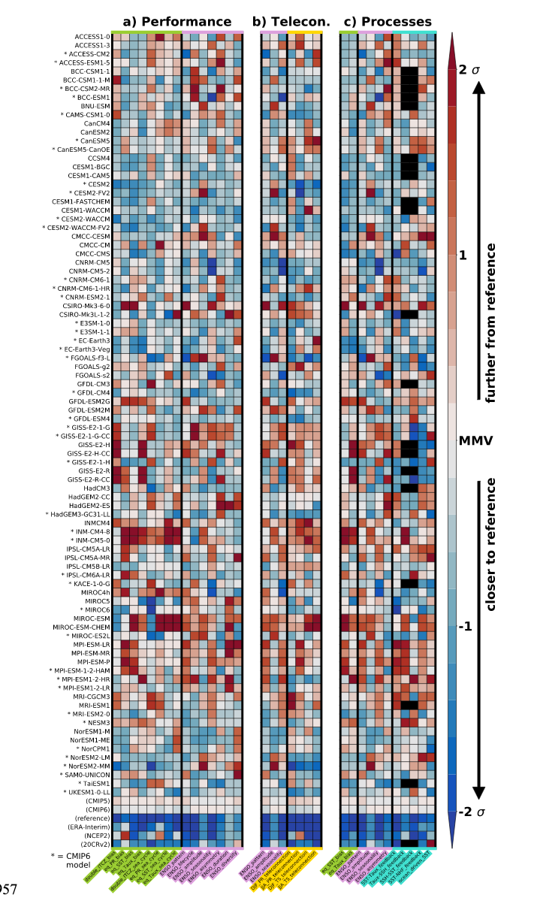

Evaluating El Niño in climate models with the CLIVAR 2020 ENSO metrics package
Scientific Achievement
With this multi-agency collaboration effort, we develop a software package that is for a suite of baseline metrics to evaluate the simulation of El Niño-Southern Oscillation (ENSO) variability, teleconnections and processes in Earth system models. In addition to contributing to this research, LLNL has developed a novel web-based interactive visualization of the resulting array of summary statistics and their underlying diagnostics (https://cmec.llnl.gov/results/enso/).
Significance & Impact
The El Niño-Southern Oscillation (ENSO) is the dominant mode of interannual climate variability on the planet, with far-reaching global impacts. It is therefore important to evaluate how well state-of-the-art numerical models capture the observed characteristics of ENSO.
Statistics from the CLIVAR 2020 ENSO metrics results a master portrait plot that provides the overall summary of performances
Research summary
The new CLIVAR 2020 ENSO metrics package enables rapid analysis of multi-petabyte databases of simulations, such as those generated by the Coupled Model Intercomparison Project phases 5 (CMIP5) and 6 (CMIP6). The CMIP6 models are found to significantly outperform those from CMIP5 for 8 out of 24 ENSO-relevant metrics, with most CMIP6 models showing improved tropical Pacific seasonality and ENSO teleconnections. Only one ENSO metric is significantly degraded in CMIP6, namely the coupling between the ocean surface and subsurface temperature anomalies, while the majority of metrics remain unchanged.
Planton, Y., E. Guilyardi, A. T. Wittenberg, Jiwoo Lee, Peter Gleckler, T. Bayr, S. McGregor, M. J. McPhaden, S. Power, R. Roehrig, A. Voldoire, 2020: Evaluating El Niño in climate models with the CLIVAR 2020 ENSO metrics package. Bulletin of the American Meteorological Society. doi: 10.1175/BAMS-D-19-0337.1

