Slide 1
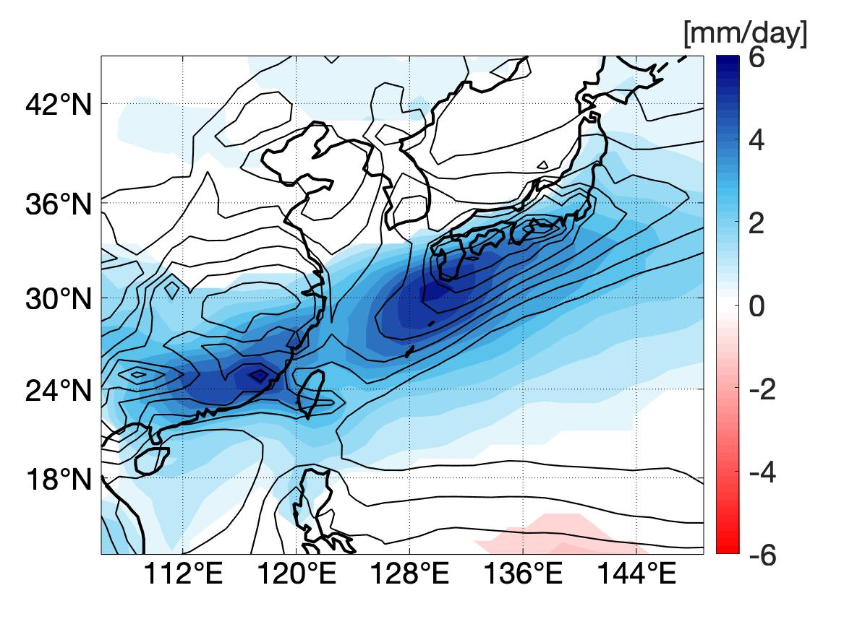
Intensification of the pre-Meiyu rainband in the late 21st century
John CH Chiang¹, Johannes Fischer², Wenwen Kong¹, and Michael J. Herman¹
¹ University of California, Berkeley CA USA ²Institute of Meteorology, University of Hamburg, Hamburg Germany
Early summer rainfall over East Asia is dominated by a rainband extending from southeastern China to southern Japan (contours)
This rainband intensifies in the late 21st century in a set of future simulations (CESM LENS RCP 8.5), and by up to 40% of the mean rainfall (shading)
The intensification is due to a delayed northward migration of the westerlies across the Tibetan Plateau, which in turn alters the atmospheric circulation downstream that converges more moisture into the rainband.
Results point to the changing westerlies impinging on the Tibetan Plateau as the cause of the rainband intensification
Chiang, J. C. H., Fischer, J., Kong, W., & Herman, M. J. (2019). Intensiﬁcation of the pre‐Meiyu rainband in the late 21st century. Geophysical Research Letters, 46, 7536 –7545. https://doi.org/10.1029/2019GL083383

