Slide 1
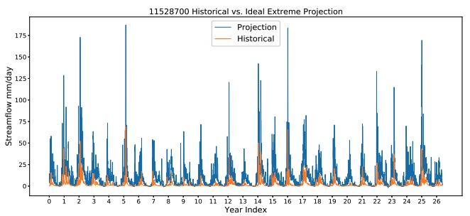
Using Convolutional Neural Networks for Streamflow Projection in California
By analyzing the sensitivities to input features and input time window size, we can distinguish different dominant physical processes for the streamflow dynamics in each basin. The difference in the dominant physical process are also reflected in the future projection.
Figure: Streamflow from an idealized test with extreme forcing.
Although LSTMs are a common choice for streamflow prediction, in this study we prove that convolutional networks are equally capable in these basins using a local training protocol. We further demonstrate that the model is stable in an idealized test with extreme future-inspired forcing, and so demonstrate the framework could be used for future projection.
A temporal convolutional neural network is designed with causal convolution and residual connections.
The model is trained with NLDAS forcing data and USGS observed streamflow.
Future streamflow projects are made with LOCA downscaled climate data.
The streamflow response and the peak day shift is analyzed.
Duan, S., Ullrich, P., & Shu, L. (2020). Using Convolutional Neural Networks for Streamflow Projection in California. Frontiers in Water, 2, 28. DOI: 10.3389/frwa.2020.00028

