Slide 1
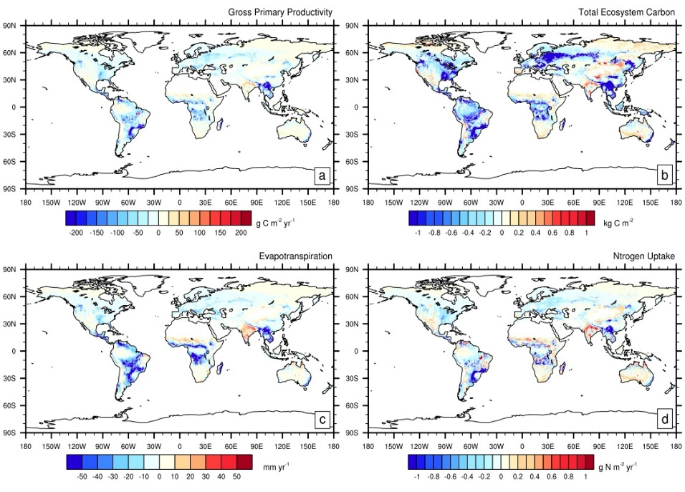
Simulating Dynamic Roots in the Energy Exascale Earth System Land Model
Objective
Integrate a dynamic root structure in the E3SM Land Model such that the vertical distribution of fine roots can respond to water and nitrogen heterogeneity in the soil to meet the demands of the plant:
When water stress is low, nutrient distribution will have strongest weight for fine root distribution
When water stress is high, water distribution will have strongest weight for fine root distribution
Approach and Results
Approach: Tested the new model and conducted sensitivity tests to evaluate water stress impacts on root distribution.
Results: The simulated root profiles generally agree with observations, indicating shallow root profiles in dry and tropical ecosystems. GPP decreases in most ecosystems that do not have strong water stress, but increases in dry and boreal systems. However, the model-estimated GPP marginally improves agreement with observations. Increasing the weight of root growth toward soil layers with water has the opposite effect, increasing GPP in most ecosystems, except for dry and boreal systems since the soil column is dried out.
Difference between the dynamic root model and the default root ELM configuration for (a) GPP (g C m-2 yr-1); (b) total ecosystem carbon (TEC; kg C m-2); (c) evapotranspiration (mm yr-1); and (d) nitrogen uptake (g N m-2 yr-1).
Impact
The model response highlights additional model processes that should be the focus of future work including: climate dependent root depth, root hydraulics, root form and function, and better nitrogen uptake.
Drewniak, B. A. (2019). Simulating dynamic roots in the Energy Exascale Earth System Land Model. Journal of Advances in Modeling Earth Systems,11. https://doi.org/10.1029/2018MS001334
Notes:
Summary:
Most Earth System Models, including the Energy Exascale Earth System Model, do not include time varying root distribution, despite evidence that indicates roots respond to their environment with foraging strategies to increase uptake of resources. I have modified the E3SM Land Model (ELM) to accommodate the root response to heterogeneity in the soil column of water and nitrogen by adding a new root growth algorithm that distributes fine roots in soil layers weighted by the water and nitrogen availability, with a preference given to water stress. Furthermore, crops were given a root depth that changed over the growing season to simulate the rapid growth of roots for crop species. This study describes the new model, and evaluates how the root distribution and gross primary productivity are changed. Next, several sensitivity experiments are run by forcing different levels of minimum water stress.
The model simulated root profiles generally agree with observations, showing shallow roots in water saturated systems and in dry and boreal ecosystems. However, the model did not capture the deep roots in the dry season tropics. Furthermore, Fig. 1 shows the model estimated GPP decreased with the default root model, especially in the dry season tropics and other wet seasonal regions. Increases in GPP are in dry and boreal ecosystems. Despite the loss of GPP, the model agreement with observations is improved slightly. The model response is the result of a stronger impact on GPP to increases in water rather than nitrogen. When roots are weighted toward nitrogen layers, water uptake decreases, therefore causing a decrease in GPP. The opposite response occurs when water stress is simulated. When higher weight of root profiles is in soil layers with water, the model responds with deeper roots and increased water uptake. The model response also highlights processes that are missing in ELM.

