Slide 1
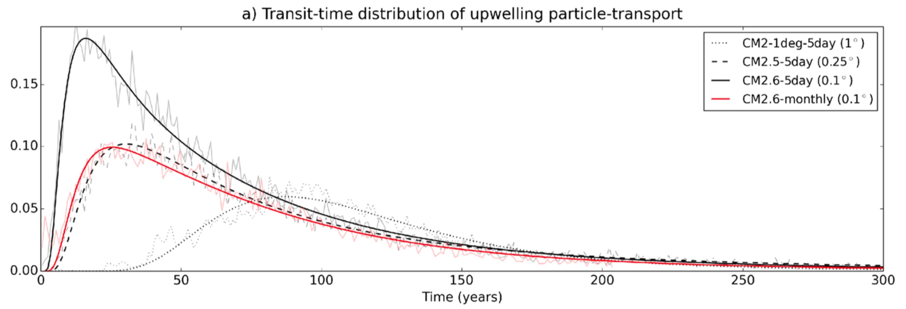
Timescales of Southern Ocean upwelling
Objective
To quantify the timescale for deep waters in the Southern Ocean to upwell to the surface, and to investigate whether resolving eddies modifies this timescale.
Figure. Transit time distributions of particle transport between release at 30°S to the 300 m depth surface in the three resolution models: CM2.6 (solid black), CM2.5 (dashed black), and CM2-1deg (dotted black). The red line shows the highest resolution model (CM2.6) with temporal smoothing of the velocity field to remove eddy variability.
Approach
3 million virtual particles were released in the deep water at 30°S, and pathways and timescales were tracked until the particles surfaced.
The particle tracking experiments were repeated in three different resolution climate models:
  GFDL CM2-1deg (1°)
  GFDL CM2.5 (0.25°)
  GFDL CM2.6 (0.1°)
Impact
Upwelling timescales of deep waters decrease from 87 years to 31 years to 17 years as the ocean resolution is refined from 1° to 0.25° to 0.1°.
An average particle completes 3.2 circumpolar loops in the 1° model in comparison to 0.9 loops in the 0.1° model.
Advective timescales and thus interbasin merging of upwelling deep waters may be overestimated by coarse-resolution models, potentially affecting the skill of centennial scale climate change projections.
H. F. Drake, A. K. Morrison, , S. M. Griffies, J. L. Sarmiento, W. Weijer, and A. R. Gray (2018), Lagrangian timescales of Southern Ocean upwelling in a hierarchy of model resolutions, Geophysical Research Letters, 48, 891-898.
Notes:
Wanda says that this is a general slide with no specific reference

