Slide 1
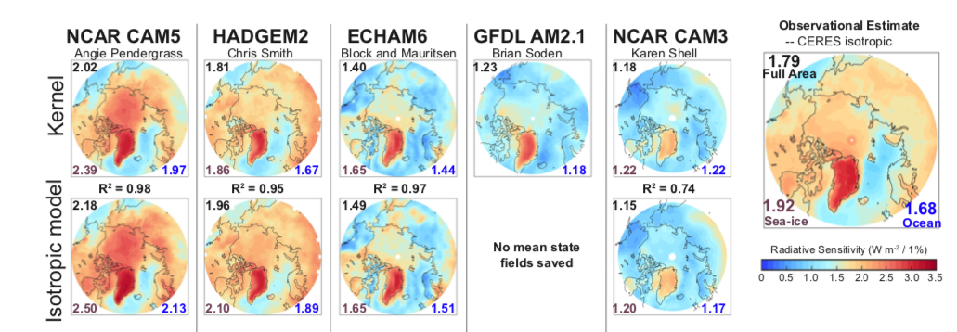
Improving Atmospheric Transmissivity Calculations in Estimates of Sea Ice Albedo Feedback
Objective
Evaluate the differences between models and observations regarding how much sunlight is absorbed as the surface reflectivity changes
Use this information to help estimate the size of the sea ice albedo feedback
Approach
Introduce and justify a simple method of calculating how much additional sunlight is absorbed as the surface reflectivity changes in the Arctic
Compare estimates using the simple method to more accurate and expensive methods available in only a few models and demonstrate they provide similar answers
Use the simple method to evaluate 22 models
Show that the method indicates that there is more variability in this quantity than previously estimated, and that new estimates affect estimates of the ice albedo feedback
Impact
Used the new technique to evaluate 18 models, and showed that variability in this factor is larger than previously estimated
Demonstrated that the ice albedo feedback is likely to be 40 percent larger than earlier estimates
Radiative sensitivity (a measure of how much sunlight the atmosphere absorbs as surface reflectivity changes) is calculated using a new method (isotropic model). It compares well to the computationally expensive Kernel calculation across several different climate models (fields unavailable for the GFDL model).
Donohoe A, E Blanchard-Wrigglesworth, A Schweiger, and PJ Rasch. 2020. “The Effect of Atmospheric Transmissivity on Model and Observational Estimates of the Sea Ice Albedo Feedback.” Journal of Climate in press.
DOI: 10.1175/JCLI-D-19-0674.1

