Slide 1
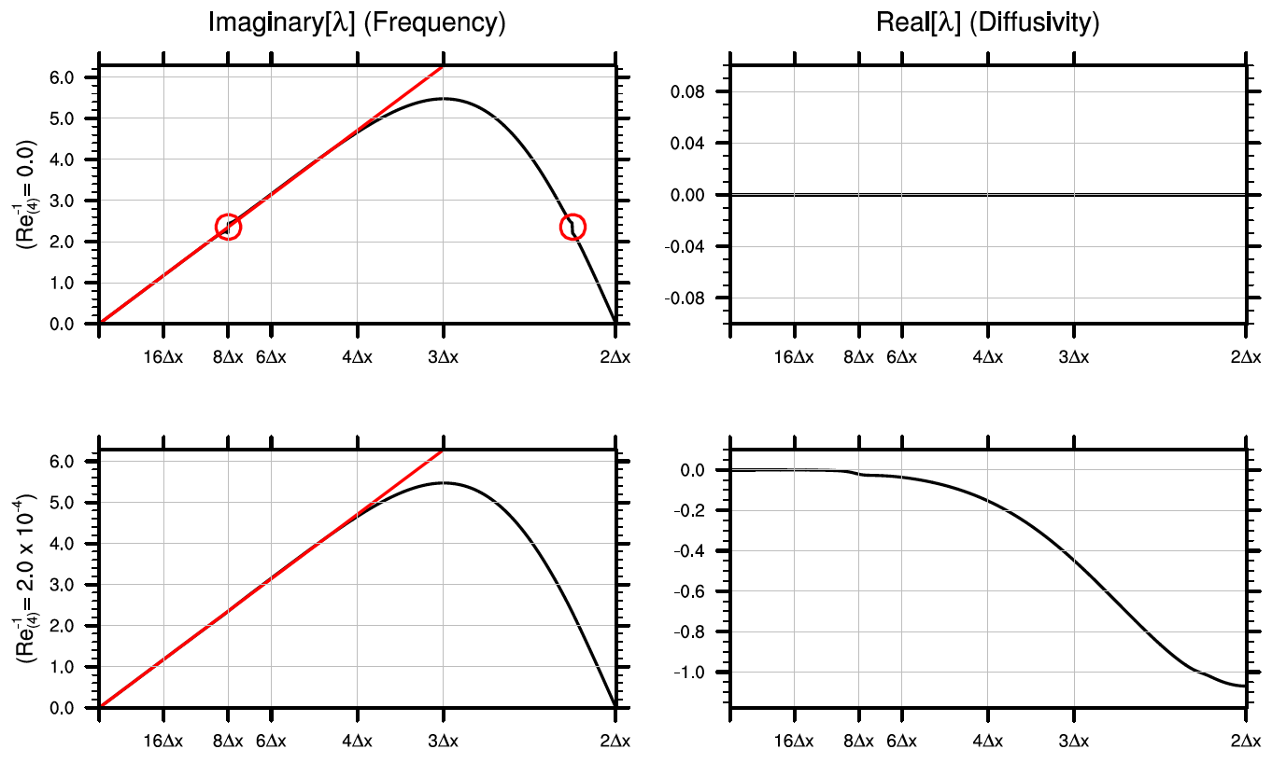
Impact and importance of hyperdiffusion on the spectral
element method: A linear dispersion analysis
Objective
This paper targets the calculation of a theoretically optimal hyperdiffusion coefficient for use in the DOE Energy Exascale Earth System Model (E3SM) non-hydrostatic spectral-element dynamical core. The selection of such a coefficient would be effective at eliminating the spectral gap and improving the accuracy of the dynamical core.
Approach + Results
Hyperdiffusion is generally effective at improving errors in the representation of physical wave modes and improving errors in the phase speed of discrete wave modes.
The KG53 scheme with time-split hyperdiffusion allows us to achieve the largest stable timestep among all Runge-Kutta schemes investigated.
A number of comprehensive analysis scripts have been developed in conjunction with this research.
Figure: An appropriate choice of hyperdiffusion coefficient is effective at eliminating the spectral gap and improving the treatment of wave modes within the spectral element model.
Impact
Determination of an optimal hyperdiffusion coefficient allows us to minimize diffusive errors and computational cost while maximizing the accuracy of the model’s dynamical core.
Citation: Paul A. Ullrich, Daniel R. Reynolds, Jorge E. Guerra, Mark A. Taylor, “Impact and importance of hyperdiffusion on the spectral element method: A linear dispersion analysis,” Journal of Computational Physics, 2018, doi: 10.1016/j.jcp.2018.06.035.
Notes:
Summary:
The DOE Energy Exascale Earth System Model (E3SM) project is developing a new nonhydrostatic dynamical core built using the spectral element method. In this model hyperdiffusion is utilized to stabilize the model and to remove high-frequency noise that can contaminate the physical solution. The goal of this work is to understand the theoretically optimal choice of hyperdiffusion coefficient that would allow for the best trade-off between model accuracy, while limiting computational cost. Although the linear dispersion properties of the spectral element method without diffusion have been analyzed extensively for the case of the 1D inviscid advection equation, practical implementations of the SEM require hyperdiffusion for stabilization. As argued in this paper, hyperdiffusion has a pronounced impact on the accuracy of the discrete wave modes and the dispersive properties of the SEM. When applied with an appropriately large coefficient, hyperdiffusion is effective at removing the spectral gap and improving the stability of the 1D advection equation. This study also considers the SEM as applied to the 2D linearized shallow-water equations, where hyperdiffusion in the form of scalar diffusion, divergence damping, and vorticity damping are analyzed.

