Slide 1
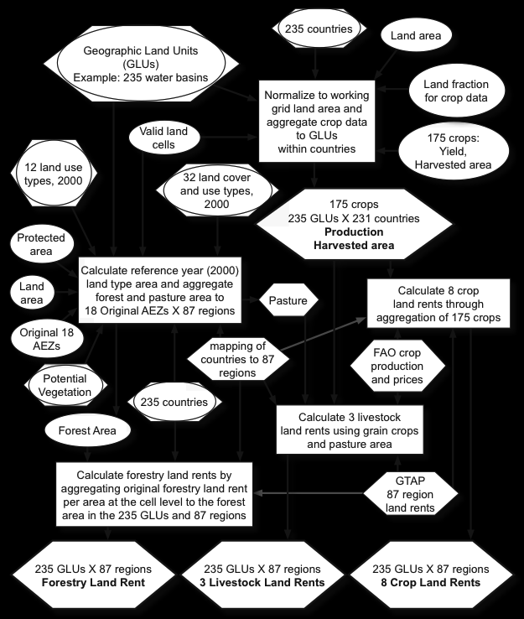
Moirai version 3: A data processing system to generate recent historical land inputs for global modeling applications at various scales
Scientific Achievement
Moirai is open source software for integrating physical and economic land data from various sources into a self-consistent data set for initializing and bounding global models. Moirai:
ensures robust land data for models
raises confidence in model results
Facilitates uncertainty quantification.
enables more efficient data updates
Significance and Impact
Moirai is available for use and customization by the modeling community, which facilitates improved model comparison exercises due to data standardization. Data updates and additions are also more efficient with Moirai as a basis.
Research Details
Moirai is efficient, written in C, and provides custom spatial aggregation of:
Crop harvested area, production, irrigated/rainfed area, and water footprint
Carbon densities of unmanaged land, historical land use/cover, and land value
Data integration workflow for three primary outputs aggregated to water basin within each country: crop harvested area, crop production, and land value
A.V. Di Vittorio, C. Vernon, S. Shu, 2020, “Moirai version 3: A data processing system to generate recent historical land inputs for global modeling applicatins”, Journal of Open Research Software. doi: 10.5334/jors.266.
Moirai v3.0.1 released 8/18/2019, doi: 10.5281/zenodo.3370875

