Slide 1
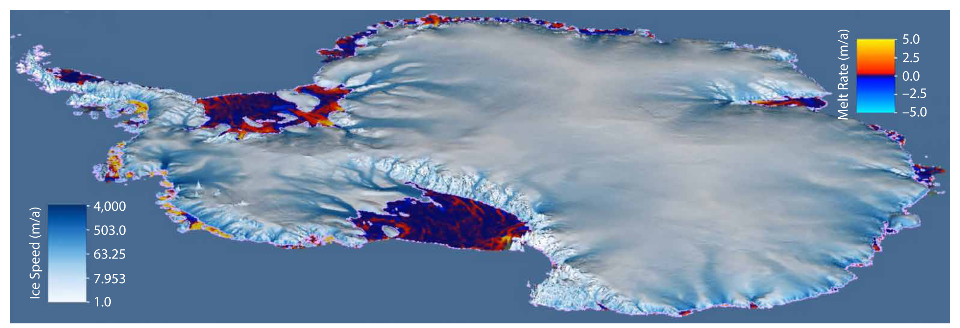
Modeling ice shelf/ocean interaction in Antarctica: A review
Science
Rapid Antarctic mass loss is observed where ice streams flow into the ocean, forming ice shelves. This paper reviews techniques for modeling ice shelf/ocean interactions, discussing new approaches that are expected to improve our ability to project ice-shelf melting in a changing climate.
Impacts
We summarize ice sheet/ocean modeling for a general audience
We summarize important work for developers of new ice shelf/ocean models to start from
We encourage model developers to pursue several promising directions: unstructured grids, full coupling, tides
Melt rates (plotted on ice shelves) and ice velocities (plotted on grounded ice) from a coupled ice sheet/ocean pan-Antarctic simulation with the DOE POPSICLES model.
Summary
Physics of ice shelf/ocean interactions
Horizontal res. and unstructured grids
Missing processes such as tides
Projections of sub-ice-shelf melting
Ice sheet/ocean coupling
Model Intercomparison Projects
Ice shelves in Earth System Models

