Slide 1
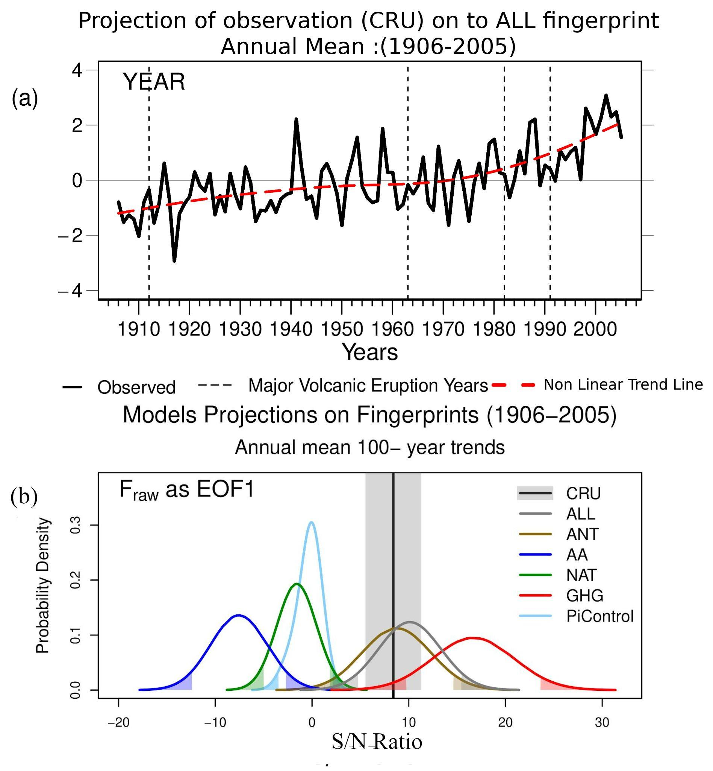
On the emergence of human influence on surface air temperature changes over India.
Problem: Investigate the causes of changes in near-surface temperature changes over the Indian region from 1906 to 2005.
Results:
The observed variations in temperature are inconsistent with unforced variability at the 1% significance level.
The increase in temperature is mainly due to increases in greenhouse gases but partially offset by anthropogenic aerosols.
Conclusions & Impacts:
Our results indicate that internal variability alone cannot explain the observed changes in surface air temperature.
The results of pattern based detection and attribution analysis are sensitive to the choice of observational dataset.
Our analysis provides strong evidence that the increase in TAS in the annual mean and every season is primarily due to human-induced increases in GHG and partially offset by AA forcing.
Dileepkumar R AchutaRao, Bonfils, Arulalan, 2021, On the emergence of human influence on surface air temperature changes over India. JGR-A 10.1029/2020JD032911

