Slide 1
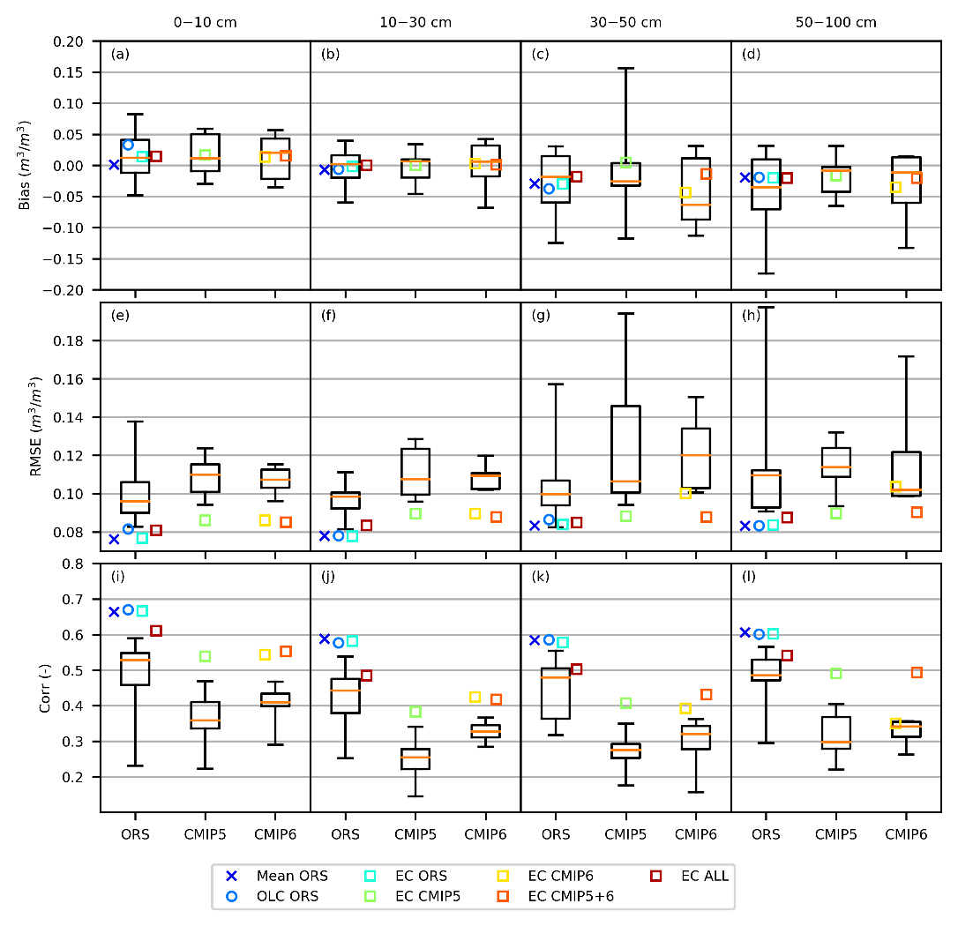
Development of Observation-based Global Multi-layer Soil Moisture Products for 1970 to 2016
Objective: To develop seven global gap-free, long-term (1970-2016) multi-layer (0–10, 10–30, 30–50, and 50–100 cm) soil moisture (SM) products at monthly 0.5º resolution.
Approach: Synthesize a wide range of SM datasets using three statistical methods (unweighted averaging, optimal linear combination, and emergent constraint).
Results/Impacts: The merged products outperformed their source datasets when evaluated with various observations. Despite uncertainties, these hybrid products create added value over existing SM datasets because of the performance improvement and harmonized spatial, temporal, and vertical coverages, and they provide a new foundation for scientific investigation and resource management.
Figure: Performance of the original ORS, CMIP5, and CMIP6 datasets (boxplots) and the merged products (scatter plots) on the validation set of observations.
Wang, Yaoping, Jiafu Mao, M. Jin, Forrest M. Hoffman, Xiaoying Shi, S. D. Wullschleger, and Y. Dai. March 16, 2021. “Development of Observation-based Global Multi-layer Soil Moisture Products for 1970 to 2016.” Earth System Science Data, 13, 4385-4405, httpts://doi.org/10.5194/essd-13-4385-2021.

