Slide 1
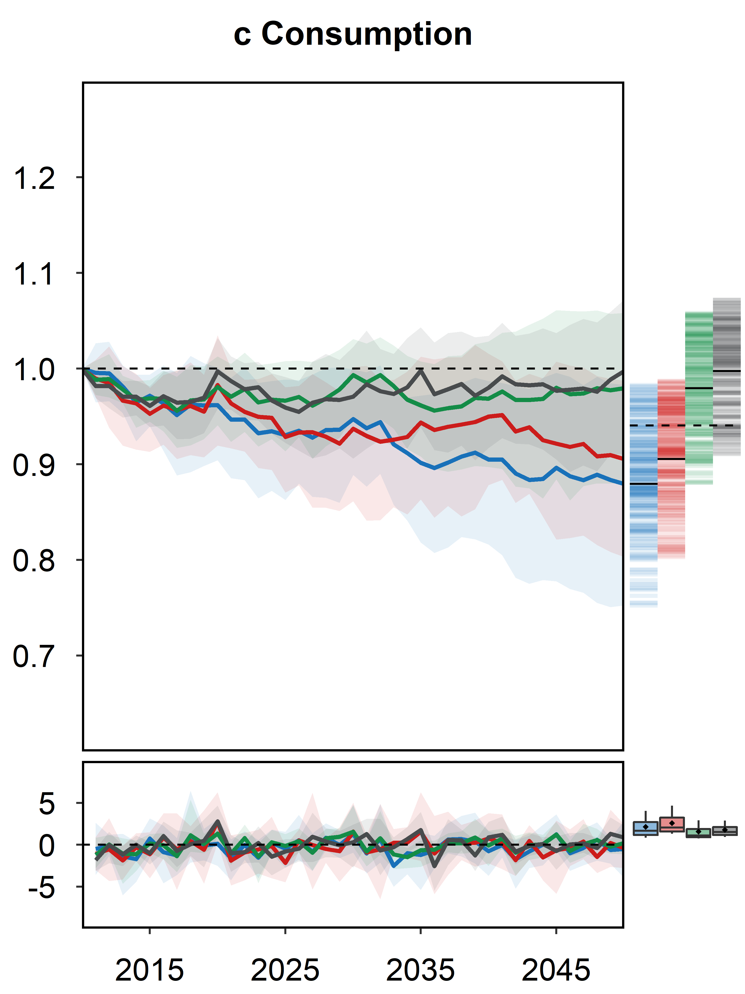
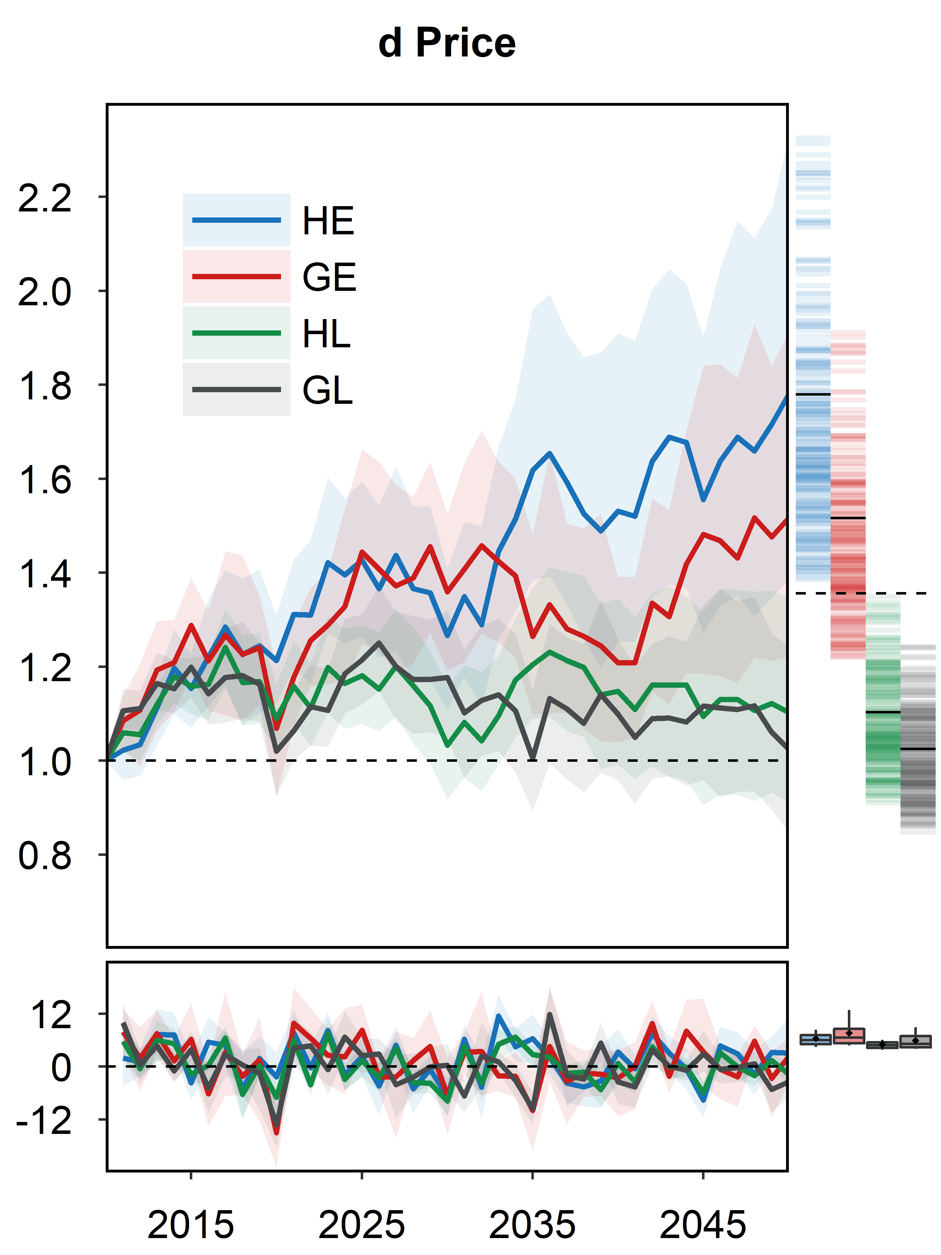
Higher Sensitivity of Global Agricultural Markets to Interannual Climate Variability
Objective
Investigate the relationship between climate variability and agricultural market responses, then assess the interannual variability of climate impacts on global agriculture.
Approach
Incorporate adaptive expectation into the Global Change Analysis Model and modify the model to use annual time steps.
Translate climate variables into biophysical yield shocks and then assess the economic responses using climate, crop, and economic models.
Investigate the interannual variability of market responses under four alternative climate scenarios.
Impact
The results showed a strong transmission of interannual variations in climate-induced biophysical yield shocks to agriculture markets. The variations are further magnified by producers’ imperfect expectations of market and weather conditions.
Provided fundamentally new insights for measuring climate impacts and laid the foundation for further investigations of the full range of climate impacts on biophysical and human systems.
a Consumption
b Price
Climate impact
(2010 = 1)
Interannual
impact (%)
The interannual climate impacts on global agricultural consumption and prices by mid-century across four climate and biophysical scenarios (RCP 8.5). Scenarios with lower mean impacts show higher interannual variability, e.g., GL & GE. The standard “perfect foresight” assumption underestimates the interannual variability of consumption and prices by 41% and 55%, respectively, on average.
Zhao X, KV Calvin, MA Wise, PL Patel, AC Snyder, ST Waldhoff, MI Hejazi, and JA Edmonds. 2021. “Global agricultural responses to interannual climate and biophysical variability.” Environmental Research Letters, 16: 104037.
[DOI: 10.1088/1748-9326/ac2965]
Notes:
http://www.pnnl.gov/science/highlights/highlights.asp?division=749

