Slide 1
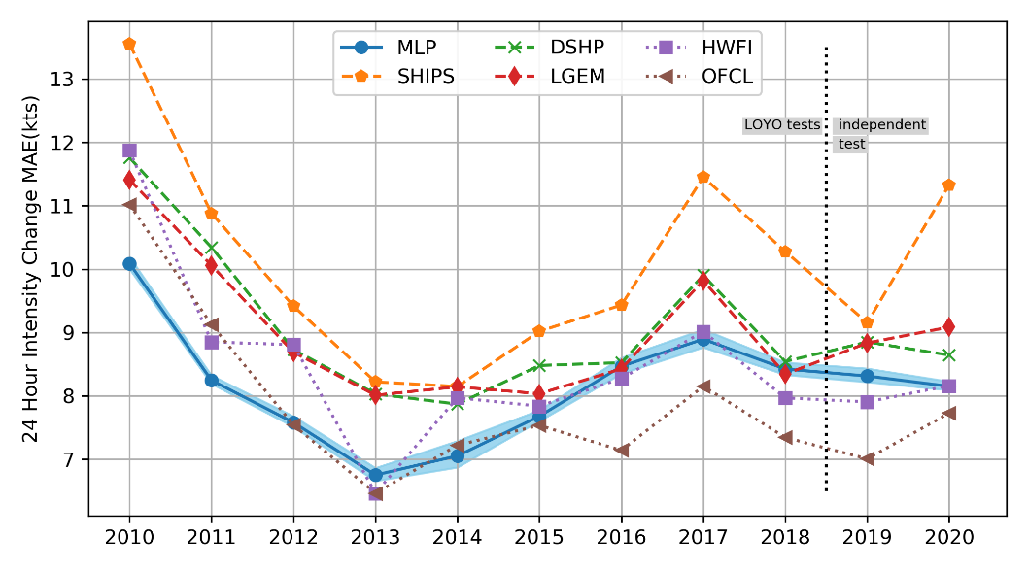
Increasing Tropical Cyclone Intensity Forecast Accuracy with a Deep-Learning-Based Model
Objective
Develop a new tropical cyclone (TC) intensity forecasting model that helps provide more accurate TC predictions.
Approach
Use Multilayer Perceptron (MLP) as an advanced statistical approach for predicting TC intensity change.
Optimize neural network architecture and hyperparameters automatically to fully explore the potential of MLP in predicting TC intensity.
Apply the MLP method to climate-scale TC by coupling climate model simulated environmental conditions with a synthetic track model and an MLP-based intensity model.
Impact
A new deep-learning-based predictive model for North Atlantic TCs outperformed some of the most accurate operational models by 5–22%, highlighting the potential for applying deep learning to better predict extreme weather.
The shared benchmark dataset and systematic approach can aid future development of advanced machine learning algorithms for TC intensity forecasting and potentially improve TC warnings.
A newly developed deep-learning-based TC intensity model (MLP) more accurately forecasts 24-hour intensity change than several current operational models (SHIPS, DSHP, and LGEM) by 5–22% when independently tested on the 2019–2020 Atlantic TCs.
W. Xu, K. Balaguru, A. August, N. Lalo, N. Hodas, M. DeMaria, & D. Judi. "Deep Learning Experiments for Tropical Cyclone Intensity Forecasts," Weather and Forecasting, 36, 1453-1470, (2021). DOI: 10.1175/WAF-D-20-0104.1
Notes:
http://www.pnnl.gov/science/highlights/highlights.asp?division=749

