Slide 1
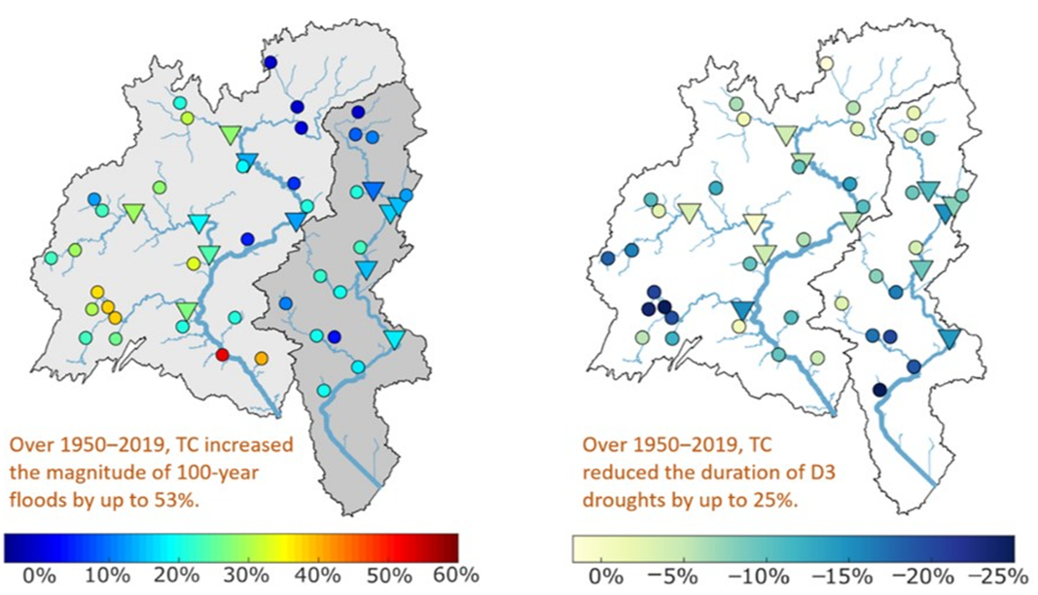
Tropical Cyclones Affect Mid-Atlantic Flood and Drought Variability
Objective
Provide a climatological analysis of observed hydrological extremes over the Mid-Atlantic region induced by tropical cyclones (TCs) from 1950‒2019.
Approach
Analyze the characteristics of TC-related precipitation at the subbasin level by linking long-term observations of hurricane tracks and gridded precipitation.
Identify the influence of TCs on the magnitude of extreme floods and the severity of droughts by linking long-term observations of hurricane tracks and streamflow records (from 50 U.S. Geological Survey gauges).
Impact
Observed a strong spatial variability in TC's impact on flood/drought within the region, highlighting the importance of prioritizing locations for coastal hazard risk management and adaptation.
Highlighted the need for high-resolution models to characterize precipitation processes and system responses at decision-relevant scales.
Discovered that TCs generally amplified the flood frequency and alleviated the severity of hydrological droughts over the Mid-Atlantic region.
The impact of TCs on: (left) the 100-year flood and (right) the duration of D3 (extreme drought, < 90 days) over the Mid-Atlantic region, with dots representing the U.S. Geological Survey gauges used in the analysis. The map values indicate the percentage difference in flood or drought duration with and without, including TC induced flows in the analysis. The analysis shows the strong spatial variability of TCs’ impact on flood and drought.
Sun N, M Wigmosta, D Judi, Z Yang, Z Xiao, and T Wang. “Climatological analysis of tropical cyclone impacts on hydrological extremes in the Mid-Atlantic region of the United States.” Environmental Research Letters, In Press. [DOI: 10.1088/1748-9326/ac2d6a].
Notes:
http://www.pnnl.gov/science/highlights/highlights.asp?division=749

