Slide 1
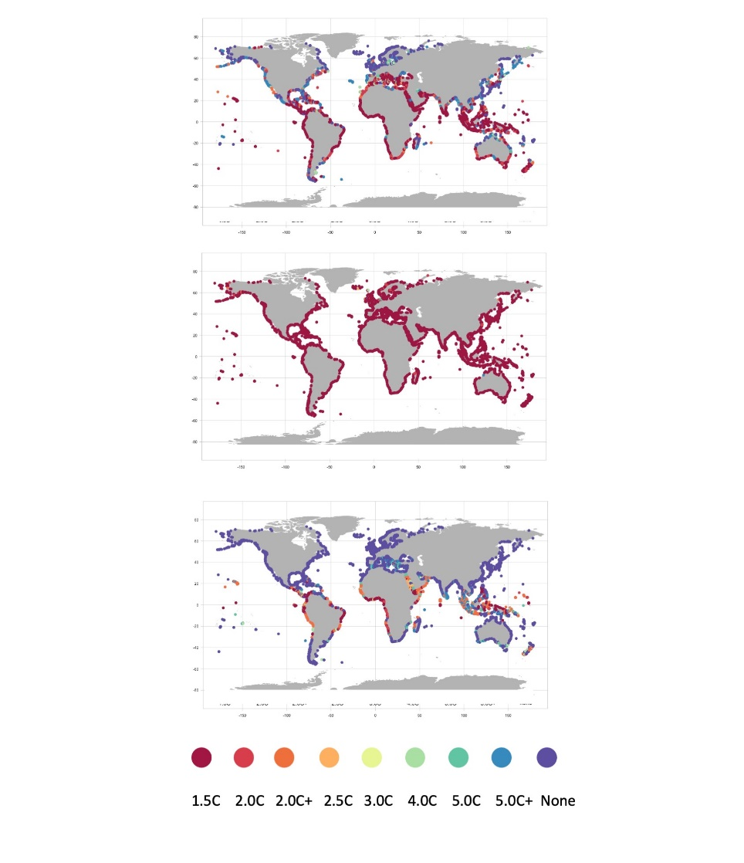
Global Warming Increases the Frequency of Extreme Sea Levels
Objective
Characterize future changes in extreme sea levels (ESLs) driven by relative sea level change at a range of global warming levels for a network of locations covering most global coastlines.
Approach
Combine three different sources of ESL estimates and two different sources of relative sea level change projections at several global warming levels.
Use empirically- and model-derived estimates as well as a novel voting system to combine the different projections.
Compared these outcomes to a more traditional convolution approach.
Impact
The estimates show how most of the studied coastlines are potentially vulnerable to an increased frequency of extreme events, even at very low global warming levels (1.5 °C or 2 °C).
Most of the changes described will likely take place well before the end of the century.
The global analysis highlights “hot-spots” that warrant further high-resolution modeling to determine potential impacts, including the U.S. Atlantic coast.
Estimated global warming levels reached by 2100 (distinguished by color) that would cause what is now a 100-yr ESL event to become at least an annual event. The central estimate, lower bound, and upper bound are shown from top to bottom, respectively. The + sign associated with 2C and 5C indicates projections that include structured expert judgment-derived estimates of the ice-sheet contribution to relative sea level change.
Tebaldi C, R Ranasinghe, M Vousdoukas, DJ Rasmussen, B Vega-Westhoff, E Kirezci, R Kopp, R Sriver, L Mentaschi. “Extreme sea levels at different global warming levels.” Nature Climate Change, (2021). [DOI: 10.1038/s41558-021-01127-1]

