Slide 1
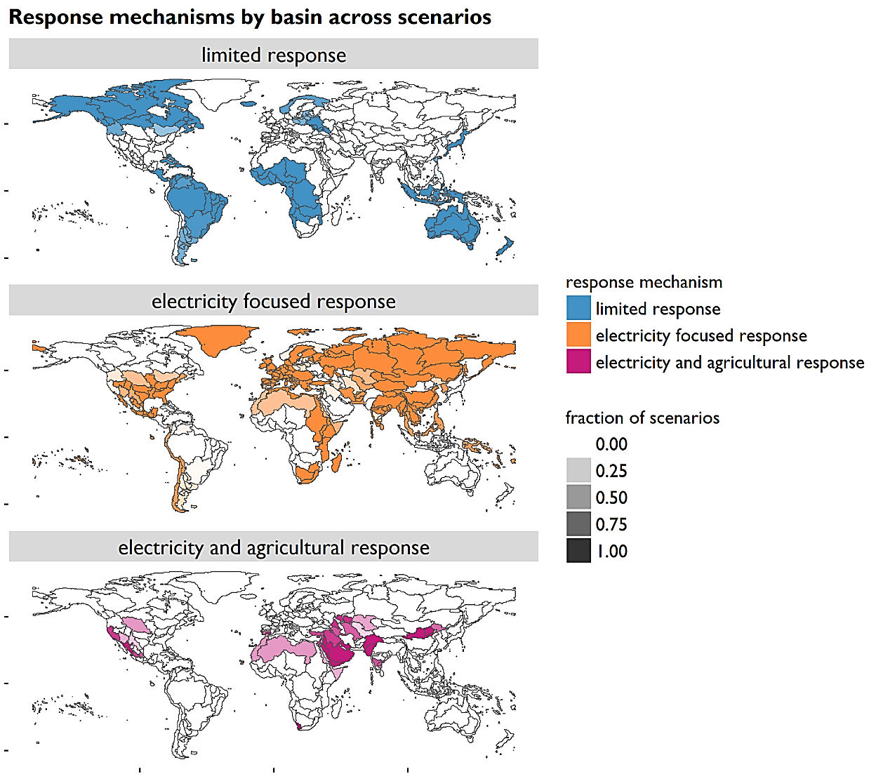
Regional Responses to Demand-Driven Water Scarcity
Objective
Understand how different regions might respond to potential future water scarcity driven by increasing water demands
Approach
Use an integrated human-Earth system model (GCAM) with regional hydrology to assess how different sectors respond to a range of future water demand scenarios
Impact
Individual water basins generally showed a consistent response across different demand scenarios
Reductions in water use for electricity production were observed in many regions; followed by reductions in irrigation water withdrawals.
The results and typology will be used for exploring global water scarcity due to both demand and supply drivers
Each map shows the fraction of scenarios in which a particular response mechanism occurred in each basin across the suite of (24) alternative water demand scenarios tested.
Cui RY, K Calvin, L Clarke, M Hejazi, S Kim, P Kyle, P Patel, S Turner, and M Wise. 2018. “Regional responses to future, demand-driven water scarcity.” Environmental Research Letters, 13(9):094006.
Notes:
http://www.pnl.gov/science/highlights/highlights.asp?division=749

