Slide 1
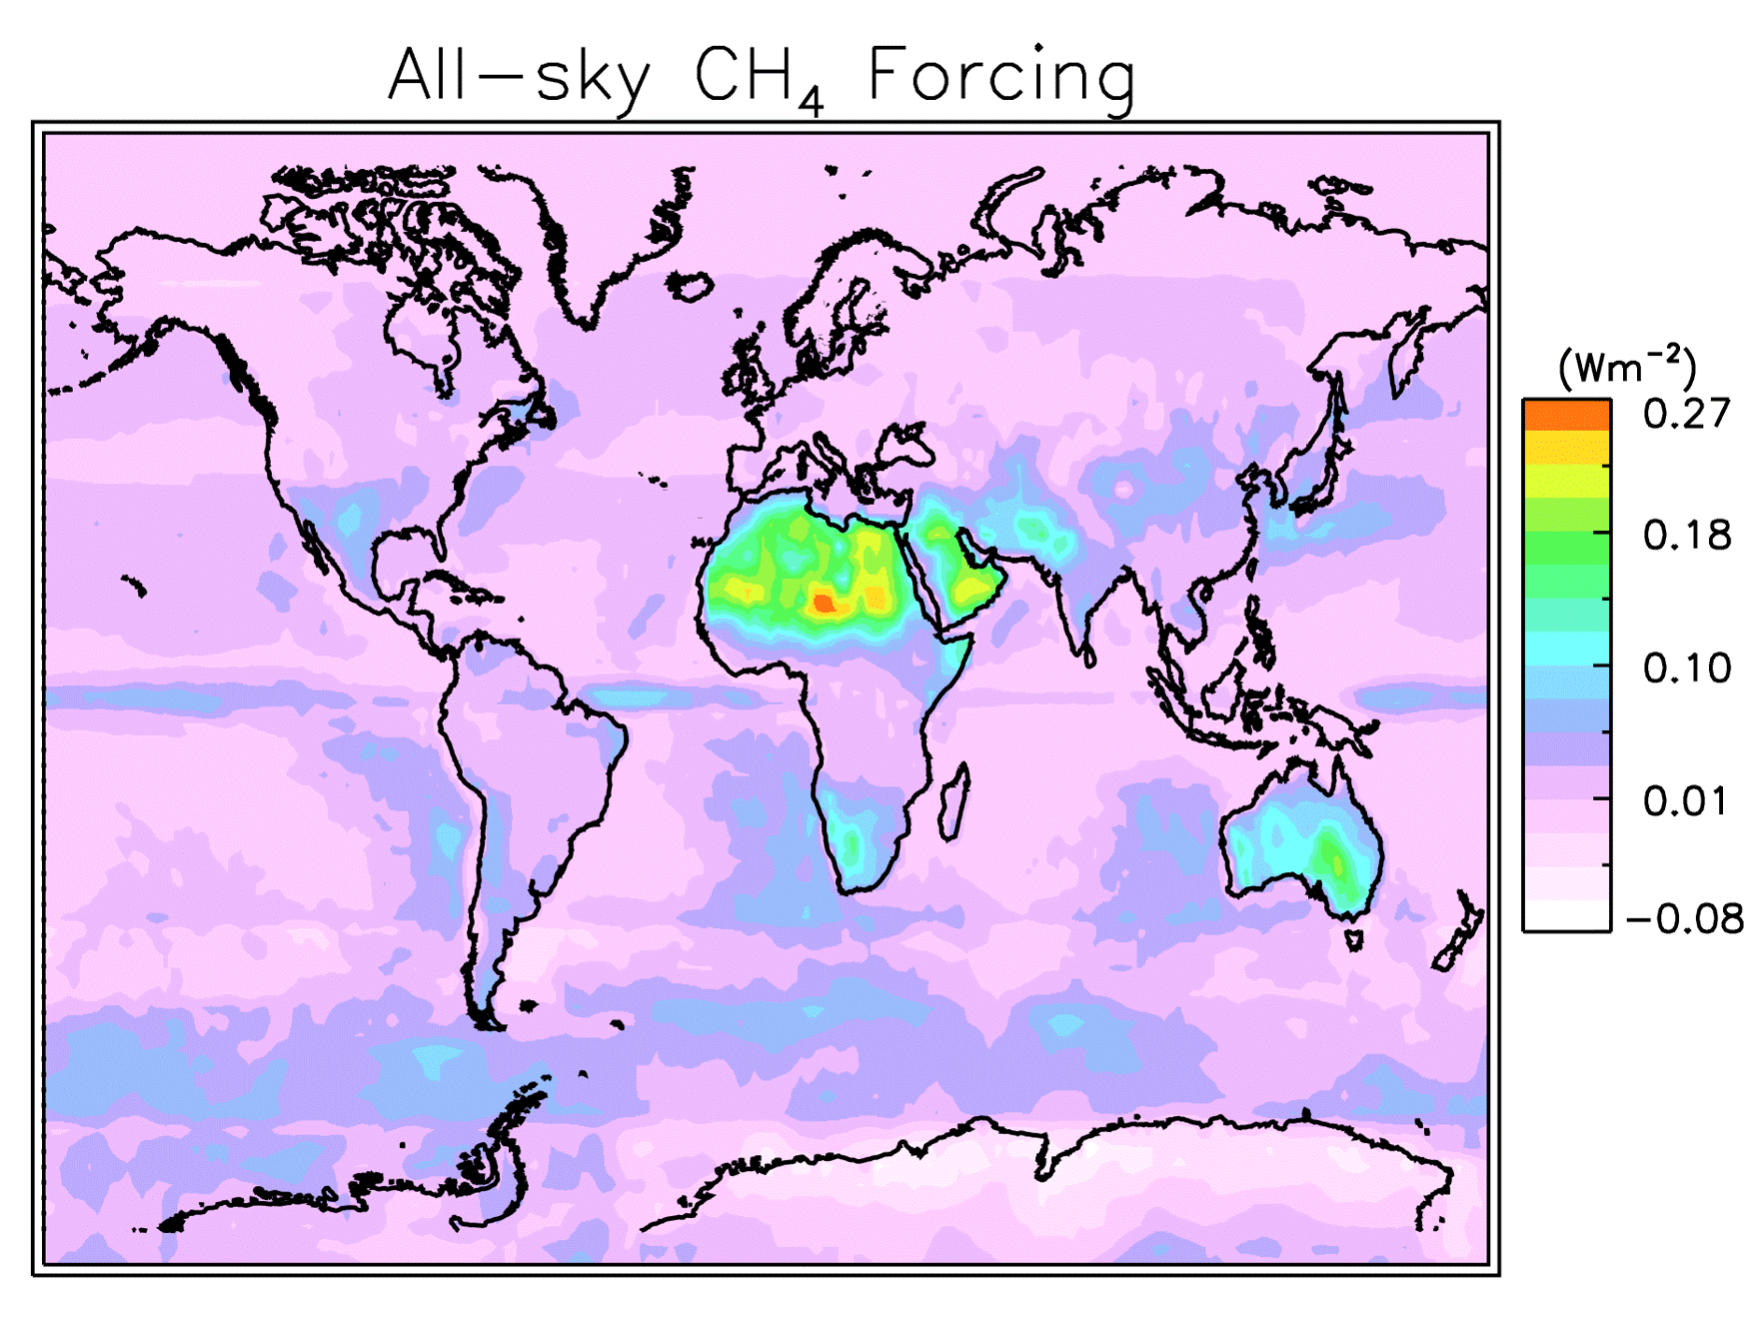
Large Regional Shortwave Forcing by Anthropogenic Methane Informed by Jovian Observations
This paper confirms that methane also heats the climate system by absorbing sunlight, and shows for the 1st time that the absorption is maximized over bright clouds and deserts.
These findings are useful for understanding the historical climate record and future projections, first by updating the relative strengths of the radiative forcing by CO₂ and CH₄, and second by highlighting the relative susceptibility of different regions to climatic effects of CH₄.
We evaluated observations of Jupiter and Titan (a moon of Saturn), where methane concentrations are more than a thousand times those on Earth, to quantify methane’s shortwave radiative effects here on Earth.
We used a climate Observing System Simulator Experiment tool to compute the temporal and spatial variation in radiative forcing by methane.
This simulation for 2006 to 2010 shows the monthly-mean total solar absorption, or radiative forcing, by methane. The most prominent feature in this movie is the elevated absorption over the Sahara Desert, Arabian Peninsula, and portions of Australia.
W.D. Collins, D.R. Feldman, C. Kuo, and N.H. Nguyen, "Large regional shortwave forcing by anthropogenic methane informed by Jovian observations", Science Advances, 4(9), (2018), doi: 10.1126/sciadv.aas9593

