Slide 1
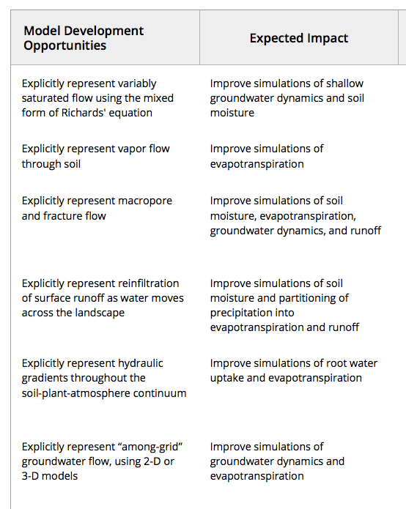
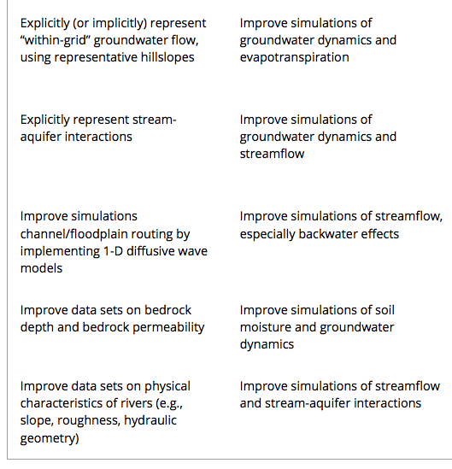
Improving the representation of hydrologic processes in Earth System Models
Objective: In this opinion paper, we outline a series of ways in which hydrologic processes could be improved in ESMs through deeper and more consistent collaborations with hydrologists.
Clark, M.P., Y. Fan, D.M. Lawrence, J.C. Adam, D. Bolster, D.J. Gochis, R.P. Hooper, M. Kumar, L.R. Leung, D.S. Mackay, R.M. Maxwell, C. Shen, S.C. Swenson, and Xubin Zeng, 2015: Improving the representation of hydrologic processes in Earth System Models. Wat. Res. Research, doi:10.1002/2015WR017096.

