Slide 1
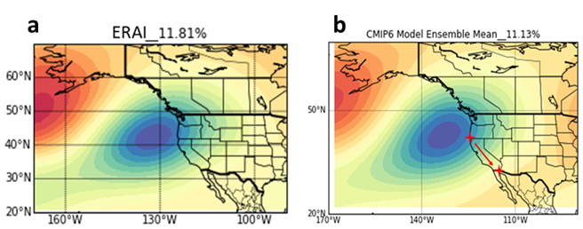
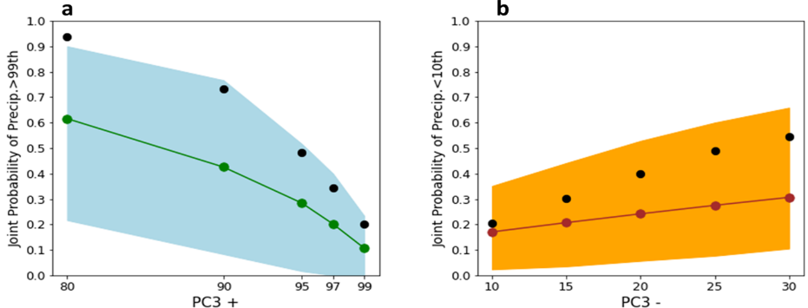

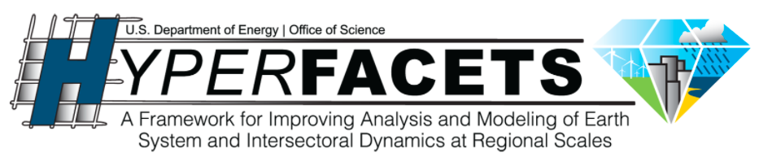

A distinct atmospheric mode for California precipitation
Scientific Achievement
Scientists at UCLA have demonstrated the existence of an influential atmospheric mode of North Pacific atmospheric pressure variability that regulates wet season precipitation variability over California (the “California precipitation mode” (CPM)). In addition to controlling mean precipitation, the CPM coincides with most of the wet extreme days and dry days over California. CMIP6 models capture the mode and its linkage with California precipitation well, boosting confidence in the models' dynamics relating to regional hydrologic extremes.
Significance & Impact
The CPM captures large-scale dynamics over North Pacific that are important for hydrologic extremes. It is also closely linked to atmospheric rivers (ARs) that make landfall over California. Besides, the CPM could help understand the origins of CMIP6 model biases and select the more credible models. The team recommends that such metric could be integrated into the process of climate model evaluation and selection for downscaling.
The spatial pattern of the CPM (EOF3 of Z500) in the (a) ERA-Interim, (b) multi-model ensemble mean.
Joint probability of California-averaged (a) extreme precipitation days with positive CPM days, (b) dry days with negative CPM days in observations (black dots), as well as 18 CMIP6 models (green and red dots for multimodel mean, shadings for intermodel range).
Research Details
The team utilized both observations and output of multiple CMIP6 models to analyze the principal components of North Pacific atmospheric pressure variability, and their joint probability with California wet extreme days and dry days. The CPM is identified as a distinct and influential atmospheric mode that captures large-scale dynamics over North Pacific that are important for hydrologic extremes.
Chen, D., Norris, J., Goldenson, N., Thackeray, C., & Hall, A. (2021). A distinct atmospheric mode for California precipitation. Journal of Geophysical Research: Atmospheres, 126, https://doi.org/10.1029/2020JD034403
Notes:
The Science
Scientists at University of California Los Angeles have demonstrated the existence of an influential mode of North Pacific atmospheric pressure variability that regulates wet season precipitation variability over both northern and southern California (the “California precipitation mode” (CPM)). The team finds that in addition to controlling wet-season mean precipitation, the CPM coincides with most of the wet extreme days and dry days over California. CMIP6 models capture the CPM remarkably well, and they also reproduce the CPM’s strong association with California wet season precipitation, boosting confidence in the models' dynamics relating to regional hydrologic extremes.
The Impact
The study identifies an influential mode (i.e., the CPM) that regulates wet season precipitation variability over California. The mode captures large-scale dynamics over North Pacific that are important for hydrologic extremes. It is also closely linked to atmospheric rivers (ARs) that make landfall over California. Besides, because CMIP6 models reproduce the CPM’s association with California precipitation, the CPM could be a useful way to understand the origins of model biases and select the more credible models for further analysis. The team recommends that such metric could be integrated into the process of climate model evaluation and selection for downscaling.
Summary
The hydrologic cycle in California is strongly influenced by wet season (November to April) precipitation. Here, we demonstrate the existence of an influential mode of North Pacific atmospheric pressure variability that regulates wet season precipitation variability over both northern and southern California. This mode, named as the “California precipitation mode” (CPM), is statistically distinct from other well-known modes of pressure variability such as the Pacific-North American pattern. In addition to controlling wet-season mean precipitation, positive days of the CPM coincide with up to 90% of the extreme (>99th percentile) precipitation days and 76% of detected atmospheric rivers (ARs) days, while the negative days correspond with 60% of the dry days. CMIP6 models capture the CPM remarkably well, including its statistical separation from the other well-known modes of pressure variability. The models also reproduce the CPM’s strong association with California wet season precipitation, giving confidence in the models' dynamics relating to regional hydrologic extremes. However, the models also exhibit biases in regional hydrologic extremes. The CPM is a useful way to understand the origins of those biases and select the more credible models for further analysis: Models with unrealistically strong gradients in the CPM pressure pattern generally over-simulate larger wet extremes and produce excessively long dry intervals in the historical period. Thus the hydrologic biases can be traced to the particular aspects of North Pacific atmospheric dynamics.

