Slide 1
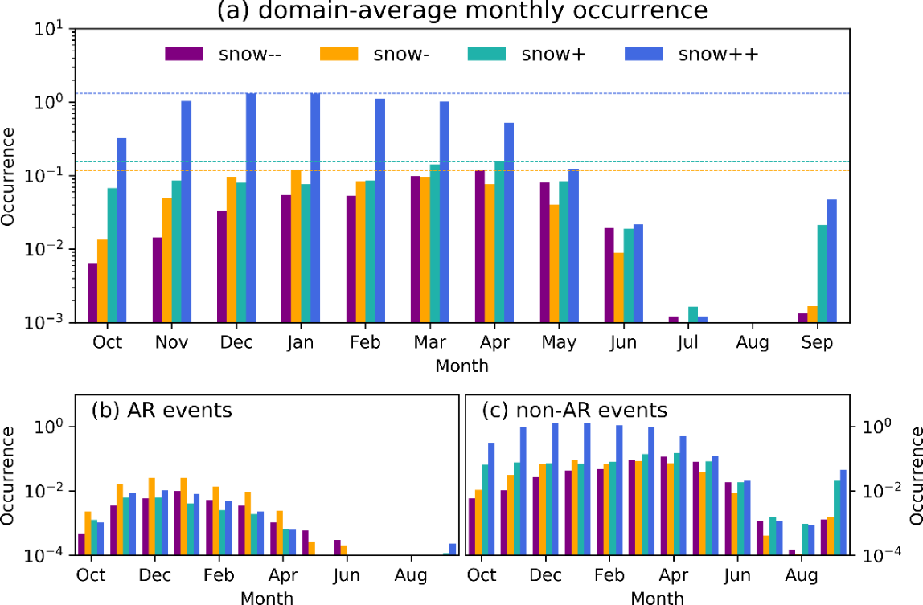
Atmospheric Rivers Trigger Heavy Snowmelt in the Western United States
Objective
Quantify the contributions of snow accumulation/melt and precipitation to runoff in the mountains of the western United States
Approach
Classify the co-occurrence of precipitation and snowpack activities into different precipitation-runoff regimes by developing a mathematical framework
Analyze a high-resolution regional climate simulation across the western United States using the framework
Impact
Study highlighted the significant snowmelt during precipitation events triggered by atmospheric rivers
Identified regions where runoff prediction can benefit from snowpack information during precipitation events
Framework can be applied to other mountainous regions where snowpack affects land-surface hydrologic processes
Graphs show the monthly cycle of the snowpack contribution to runoff across the western United States. Precipitation events are classified into four categories based on the roles of snowpack in runoff: snowpack accumulation (heavy ++ and light +) or snowmelt (heavy -- and light -). Atmospheric rivers (ARs) trigger heavy snowmelt during precipitation. All numbers are the average occurrence of such events on a model grid in the given month.
Chen X, Duan Z, Leung LR, and Wigmosta M. 2019. “A Framework to Delineate Precipitation‐Runoff Regimes: Precipitation Versus Snowpack in the Western United States.” Geophysical Research Letters 46(22):13044‒13053, https://doi.org/10.1029/2019GL085184.

