Slide 1
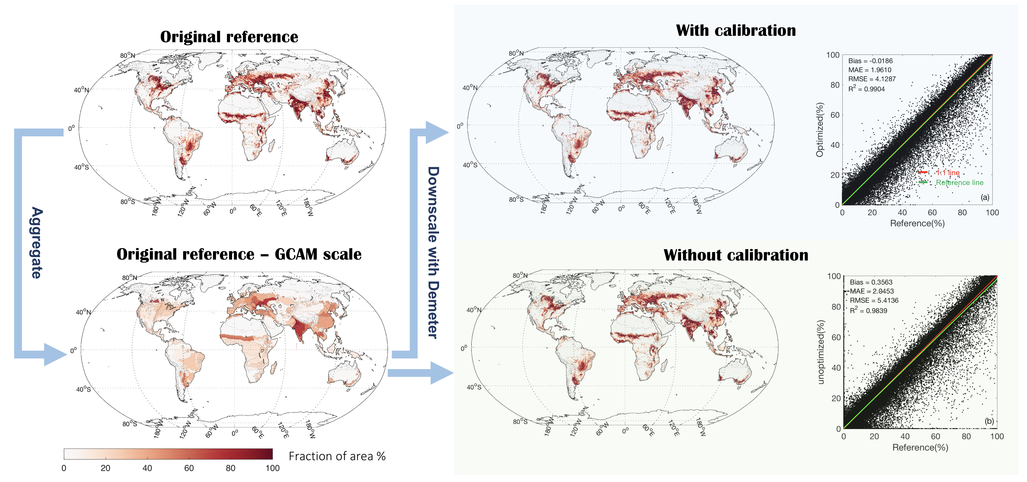
Calibration and Uncertainty Analysis of Demeter for Better Downscaling of Global Land Use and Land Cover Projections
Objective
Perform calibration and conduct sensitivity and uncertainty analyses to improve the performance of the Demeter land use and land cover change disaggregation model
Approach
Calibrate key Demeter parameters and generate their uncertainties by using long-term, global satellite-based land cover record
Explore the uncertainty propagation in Demeter applications
Impact
Identified the optimal parameter values for global applications of Demeter
Determined that intensification ratio and selection threshold were the most sensitive parameters; they need to be carefully tuned
Study provides reference for global applications of Demeter; the results are expected to help reduce uncertainties in Earth system model simulations
The calibrated Demeter model captured the observed spatial pattern of cropland more accurately than by using uncalibrated parameters. The research team calibrated key parameters using satellite-based land cover data from the European Space Agency Climate Change Initiative.
Chen M, CR Vernon, M Huang, KV Calvin, and IP Kraucunas. 2019. “Calibration and analysis of the uncertainty in downscaling global land use and land cover projections from GCAM using Demeter (v1.0.0).” Geoscientific Model Development 12:1753‒1764, https://doi.org/10.5194/gmd-12-1753-2019.
Notes:
http://www.pnnl.gov/science/highlights/highlights.asp?division=749

