Slide 1
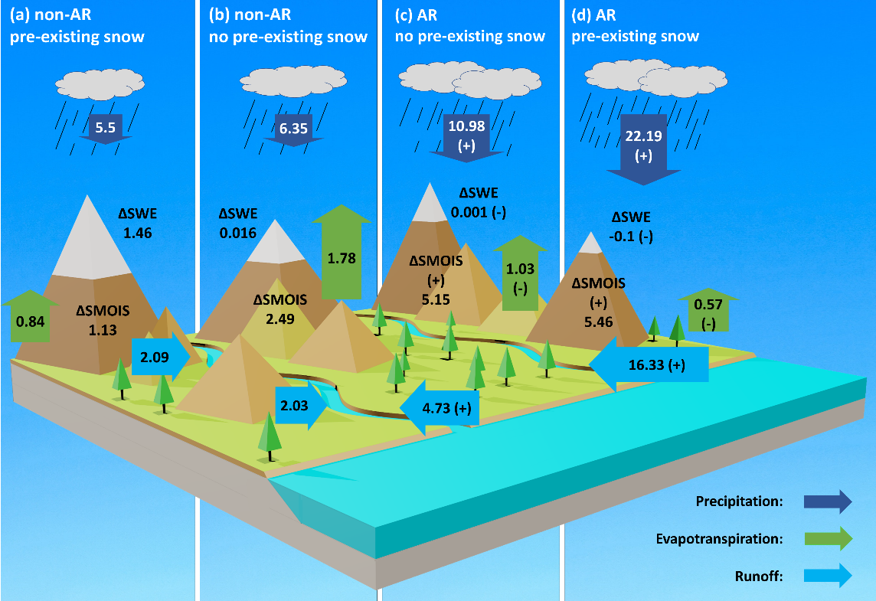
Impacts of Atmospheric Rivers on Surface Hydrological Processes in Western U.S. Watersheds
Objective
Quantify the impact of atmospheric rivers (ARs) on the surface hydrological processes and water resources in the western U.S.
Approach
Perform and analyze a 35-year high-resolution regional hydroclimate simulation
Analyze the relationship between ARs and a suite of land surface processes within and over multiple years
Impact
Identified the intensified snowmelt during ARs as a key reason for the contrasting hydrological response during AR and non-AR events
Revealed a high correlation between AR occurrence and water resource availability at annual scale along the coastal watersheds
The average land surface hydrological responses during precipitation events across the western U.S. Precipitation events are classified into four categories—(a) through (d), measured in mm/day—depending on whether precipitation is associated with ARs and whether there is pre-existing snowpack on the ground. Ground-based water storage is noted with snow water equivalent (SWE) and soil moisture (SMOIS).
Chen, X., L. R. Leung, M. Wigmosta, and M. Richmond (2019), Impact of Atmospheric Rivers on Surface Hydrological Processes in Western U.S. Watersheds, Journal of Geophysical Research, 124. DOI: 10.1029/2019JD030468

