Slide 1
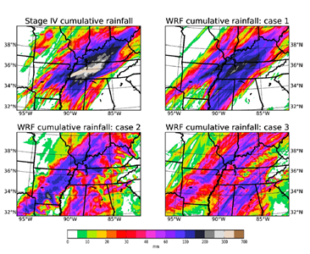
Establishing a Numerical Modeling Framework for Hydrologic Engineering Analyses of Extreme Storm Events
Objective
To establish an optimal modeling framework for extreme storm events forecasting for hydrologic engineering design and analysis
Approach
Select three heavy storm events for model testing and validation: a Nashville, TN storm in May, 2010, a northern CA storm in January, 1997, and a Pacific Northwest storm in December, 1980, all associated with atmospheric rivers
Perform simulations using the Weather Research and Forecasting (WRF) model addressing uncertainty in initial/boundary conditions, model resolution, and cloud microphysics and cumulus parameterizations
Use a wide range of metrics of precipitation characteristics to evaluate the simulations to establish an optimal configuration
Stage IV observed and WRF simulated 48-hour (0000 UTC 1 May – 0000 UTC 3 May, 2010) total rainfall during the Nashville 2010 storm event.
Impact
This study established a modeling framework that takes into consideration major uncertainty factors that contribute to the final model performance
The more physically-based method provides an important contribution to the engineering design and analyses community engaged in large water management infrastructure issues
Chen X, F Hossain, and LR Leung. “Establishing a Numerical Modeling Framework for Hydrologic Engineering Analyses of Extreme Storm Events.” (2017) Journal of Hydrological Enginneering 22(8) DOI: 10.1061/(ASCE)HE.1943-5584.0001523
Notes:
http://www.pnnl.gov/science/highlights/highlights.asp?division=749

