Slide 1
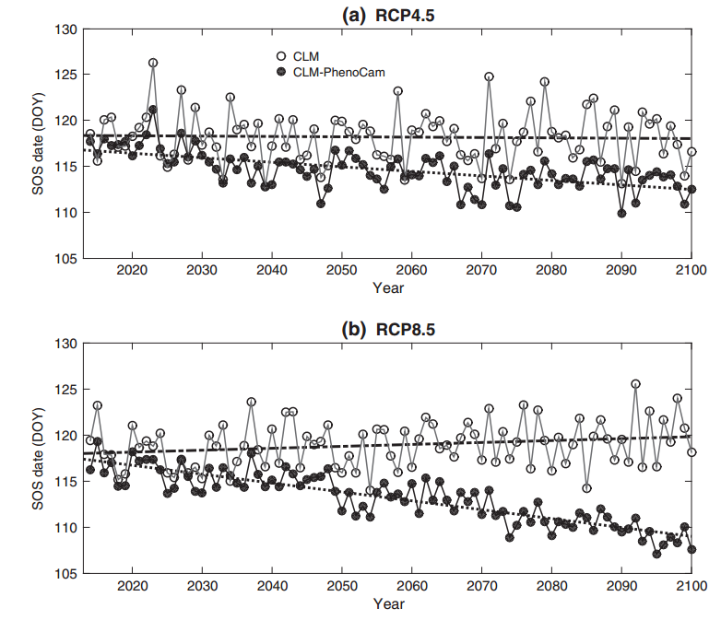
Improved phenology model for CLM predicts earlier spring for future climate scenarios
Chen et al 2016

