Slide 1
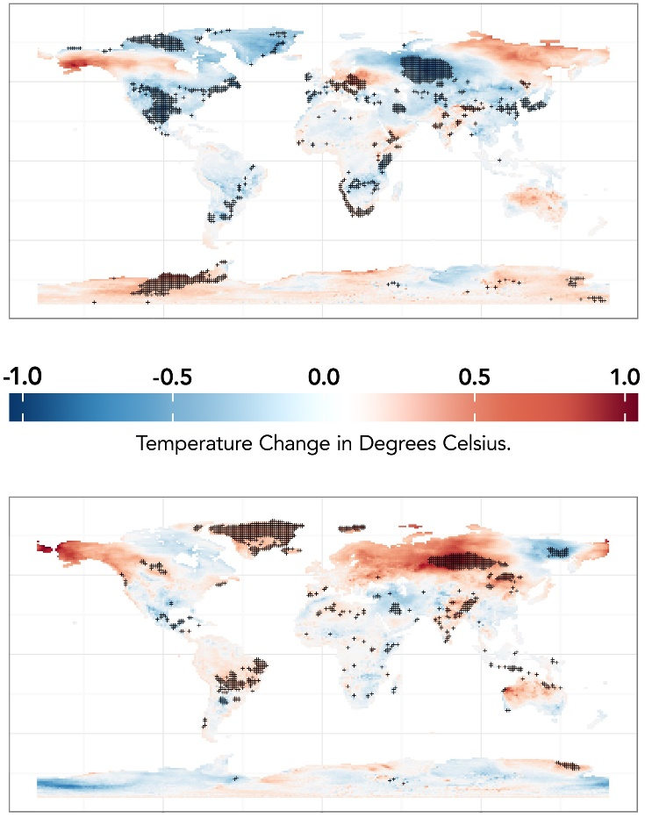
Characteristics of Human-Earth System Feedbacks Differ at Different Warming Levels
Objective
Quantify and understand the implications of human-Earth system interactions for different regions and dynamics at different levels of warming.
Approach
Use the integrated Earth System Model (iESM), which couples an Integrated Assessment Model to an Earth System Model.
Run a set of simulations with and without feedbacks for two different levels of warming (4.5 W/m² and 8.5 W/m² in 2100).
Impact
Human-Earth system feedbacks result in reduced global cropland area at both levels of warming. In the 4.5 W/m² simulation, this results in increased area for bioenergy and forests, leading to lower CO₂ emissions, higher terrestrial carbon storage, and lower CO₂ concentrations.
The effect on global mean temperature is small, but there are larger effects on local temperature (figure) some of which are statistically significant.
The effect of human-Earth system feedbacks in medium (top) and high (bottom) warming simulations. Stippling indicates statistical significance.
Calvin, K., B. Bond-Lamberty, A. D. Jones, X. Shi, A. V. Di Vittorio, and P. E. Thornton, 2019: Characteristics of human-climate feedbacks differ at different radiative forcing levels. Glob. Planet. Change, 180, 126–135, doi:10.1016/j.gloplacha.2019.06.003.

