Slide 1
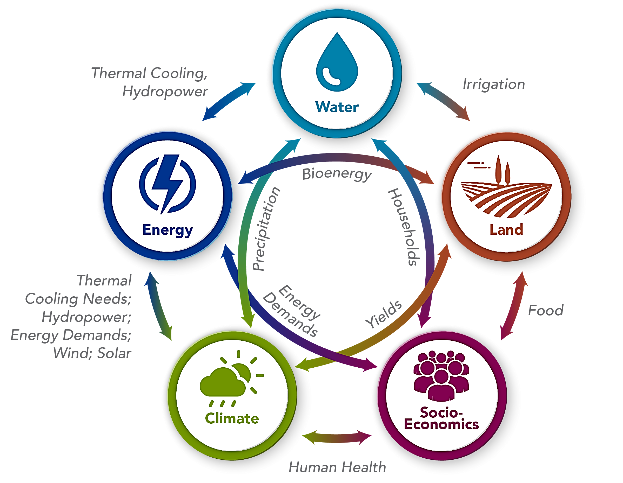
GCAM v5.1: Representing Linkages between Energy, Water, Land, Economics, and Climate
Objective
Extend and refine the Global Change Assessment Model’s (GCAM’s) representations of water, land use, socioeconomic trends, energy, and climate
Document the representations in the new version, GCAM v5.1, and provide sample results
Approach
Validate the model by comparing results for historical years to observations
Demonstrate the capabilities of the model by running, analyzing, and describing the results from eleven different scenarios
Describe each component of GCAM v5.1, including the model structure, input data, and outputs
Impact
GCAM v5.1 can examine, for example, how changes in population, income, or technology cost might alter crop production, energy demand, or water withdrawals, or how changes in one region’s demand for energy affect energy, water, and land in other regions.
PNNL’s GCAM v5.1 provides the multisector dynamics community with the ability to examine linkages between energy, water, land, climate, and economic systems.
Calvin KV, P Patel, L Clarke, G Asrar, B Bond-Lamberty, RY Cui, A Di Vittorio, K Dorheim, J Edmonds, C Hartin, M Hejazi, R Horowitz, G Iyer, P Kyle, S Kim, R Link, H McJeon, SJ Smith, A Snyder, S Waldhoff, and M Wise. 2019. “GCAM v5.1: Representing the linkages between energy, water, land, climate, and economic systems.” Geoscientific Model Development 12:677–698, https://doi.org/10.5194/gmd-12-677-2019.
Notes:
http://www.pnnl.gov/science/highlights/highlights.asp?division=749

