Slide 1
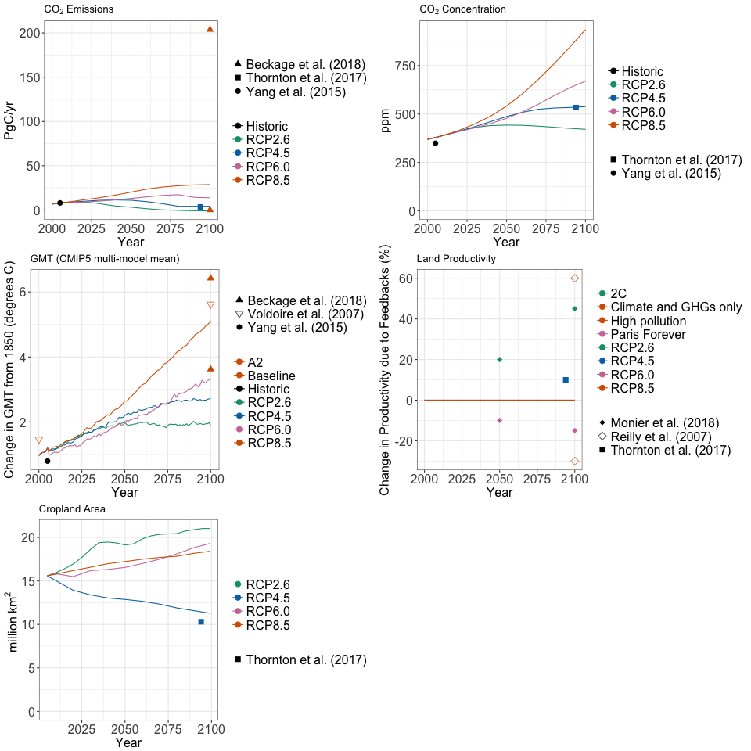
Integrating Human System Dynamics Into Earth System Models
Objective
Review the literature on two-way couplings between human and Earth system models, synthesizing current knowledge and identifying critical research gaps
Approach
Systematically and objectively review the literature; quantify the strength and direction of feedbacks considered in the literature
Identify future directions for the Earth system modeling community
Impact
Human-Earth system feedbacks have the potential to alter both systems; however, there is significant uncertainty in these results, and the number of truly integrated studies remains small
Additional research, models, and studies are needed to robustly quantify the sign and magnitude of human-Earth system feedbacks
The graphs show changes in key Representative Concentration Pathway (RCP) variables—CO₂ emissions, CO₂ concentration, global mean temperature (GMT), land productivity, and cropland area—due to feedbacks.
Calvin K and B Bond-Lamberty. 2018. “Integrated Human-Earth System Modeling–State of the Science and Future Directions.” Environmental Research Letters 13:063006. https://doi.org/10.1088/1748-9326/aac642
Notes:
The Science
Historically, Earth system models (ESMs) have considered only limited, one-way interactions with human systems and human system modeling, with key human-caused drivers of the Earth system (such as industrial emissions and land use changes) supplied by external models. Increasingly, however, researchers are exploring ways to more fully couple human systems models into ESMs as a means to explore a more comprehensive set of interactions, including impacts of the Earth system on human systems. Researchers at the U.S. Department of Energy’s Pacific Northwest National Laboratory surveyed a broad set of relevant literature on fully coupled models with two-way feedbacks between the human and Earth systems.
The Impact
This review quantifies key results emerging from the literature on feedbacks between coupled human and Earth system models. It identifies limitations in the current literature, such as the small number of studies, and outlines future research directions for better incorporating human system models and dynamics into ESMs.
Summary
In this review, researchers surveyed the literature on modeling approaches that include two-way feedbacks (i.e., interactions) between human and Earth systems and quantified the direction and strength of feedbacks emerging in those models. They then analyzed the feedbacks in context of other, more frequently considered feedbacks in the Earth system, including processes such as wildfire and permafrost thaw. Though the team found that such feedbacks have the potential to alter both human and Earth systems, the number of studies that incorporate two-way interactions remains small. Additional research, models, and studies are needed to robustly quantify the sign and magnitude of human-Earth system feedbacks. Integrating human systems into ESMs entails significant complexity and cost, and researchers should carefully assess the costs and benefits of doing so with respect to the object of study.

