Slide 1
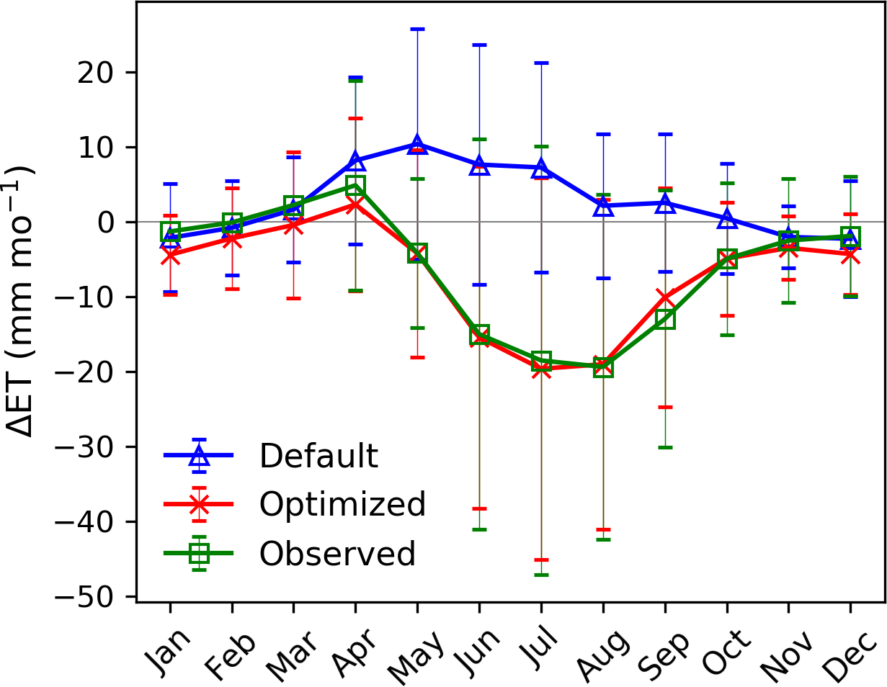
Improving Representation of Deforestation Effects on Evapotranspiration in the E3SM Land Model
Scientific Achievement
Calibration improved the representation of deforestation effects on evapotranspiration
The improved model predicted large changes in surface energy budgets associated with deforestation, particularly in tropical rainforests
Significance and Impact
Improved land‐atmosphere coupling in E3SM
Facilitated E3SM’s use in land-use change analyses.
Highlighted that future model development should focus on stomatal resistance and soil water‐related parameterizations.
Figure. Observed and simulated seasonal cycles of evapotranspiration (ET) differences between open canopy and forest towers (open‐forest).
Research Details
Optimized the E3SM Land Model (ELM) to match observations at 29 pairs of FLUXNET sites.
Improved ELM’s parameterization of stomatal characteristics, photosynthesis, and soil water dynamics.
Applied the optimized ELM to global simulations.
Cai, X., Riley, W. J., Zhu, Q., Tang, J., Zeng, Z., Bisht, G., & Randerson, J. T. (2019). Improving representation of deforestation effects on evapotranspiration in the E3SM land model. Journal of Advances in Modeling Earth Systems, 11. doi:10.1029/2018MS001551.

